Slide 1
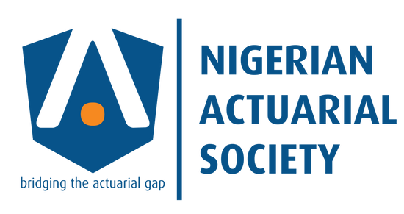
Future of the insurance industry
Web 3.0

Slide 2
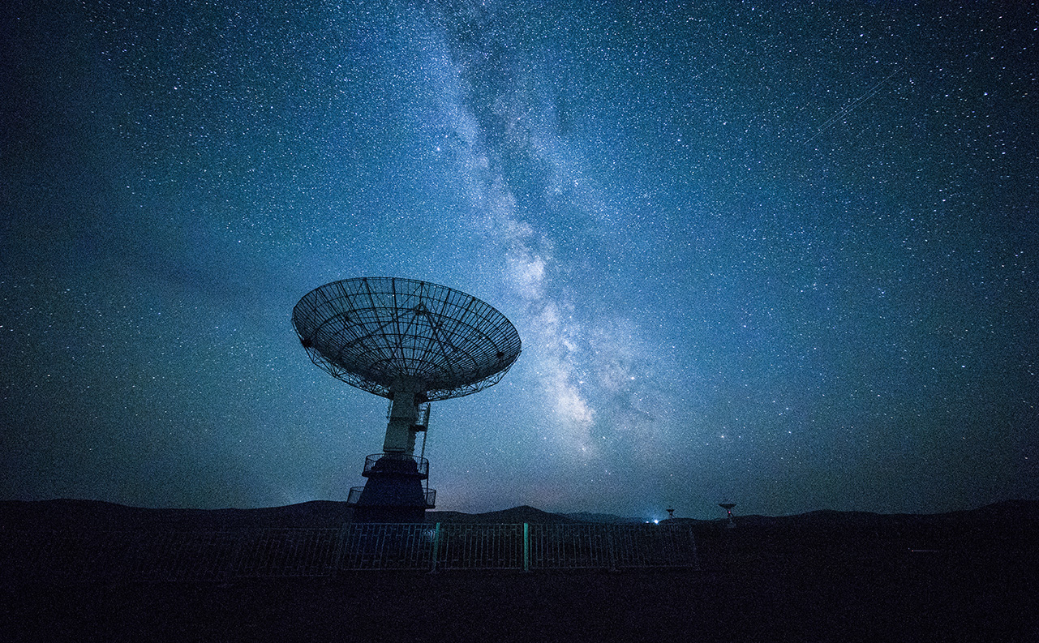
Evolution of the web
Web 1.0
Web 2.0
Web 3.0

Slide 3
Design framework of web 1.0
The era of Web 1.0 was roughly from 1991 to 2004.
Web 1.0 is a content delivery network (CDN) that enables the showcase of the piece of information on the websites
It can be used as a personal website
It has directories that enable users to retrieve a particular piece of information.
WEB 1.0
Static pages
Content is served from the server’s file system
Common Gateway Interface
Frames and Tables

Slide 4
Design ESSENTIALS of web 2.0
The era of Web 2.0 commenced in 2004.
Web 2.0 is also called the participative social web.
Web 2.0 refers to worldwide websites which highlight user-generated content, usability, and interoperability for end users
Information flows between the site owner and site users by means of evaluation & online commenting.
WEB 2.0
Dynamic content
Information flow
Developed APIs
Information Sorting

Slide 5
Design ESSENTIALS of web 2.0
Free sorting of information, permits users to retrieve and classify the information collectively
Dynamic content that is responsive to user input.
Developed APIs to allow self-usage, such as by a software application.
Web access leads to concern different, from the traditional Internet user base to a wider variety of users.
WEB 2.0
Dynamic content
Information flow
Developed APIs
Information Sorting

Slide 6
Where the future is: Web 3.0
Semantics Web: The semantic web improves web technologies in demand to create, share and connect content through search and analysis based on the capability to comprehend the meaning of words, rather than on keywords or numbers.
AI: Combining this capability with natural language processing, in Web 3.0, computers can distinguish information like humans in order to provide faster and more relevant results. They become more intelligent to fulfill the requirements of users.
Connectivity: With Web 3.0, information is more connected thanks to semantic metadata. As a result, the user experience evolves to another level of connectivity that leverages all the available information
Smart Contract: With the help of DLT we can have a virtually impossible to hack database from where one can have a value to their content and things they can own virtually, this is the technology which enables a trustless society by the integration of smart contracts which does not need to have a middle man to be guarantor to make that contract occur on certain cause its based on data from that DLT. Its a powerful tool which can make the world far more better place and generate more opportunity for everyone in internet.
Semantics Web
Voice Recognition
Artificial Intelligence
VR
Smart Contract
Connectivity
Ubiquity

Slide 7
Overview of Web 3.0 in the Insurance Space
Web 3.0, also known as the "Semantic Web," is built upon edge computing, machine learning and decentralized data architecture.
The decentralization of data leverages blockchain technology that creates an open, secure and transparent environment, enabling participants on the network to interact without requiring an intermediary, while ensuring that data ownership resides with the users. Combined with artificial intelligence, the expectation is for web 3.0 to create efficiencies in the financial system and deliver a smarter user experience.
Web 3.0 mainly focuses on connecting data in a decentralised way, rather than having it stored in centralised repositories, with computers able to interpret information as intelligently as humans.
As such, users and machines will be able to connect more seamlessly with data, meaning that artificial intelligence (AI) will play a crucial role in making this version of the internet more intelligent and powerful in terms of its ability to process information.
Ultimately, this will enable machines to more granularly interpret the meaning behind the data—or its semantics—to deliver significantly smarter user experiences.
The technology is poised to make filing insurance claims and eliminating false claims a reality of Web 3.0. It will also open the world to the reality of Open Banking, something that has been seen as a distant dream since forever.

Slide 8
What does Web 3.0 mean to INSURANCE?
How does the blockchain fit in the Insurance space?
From distributed ledger technology to real-time data collection and claims automation, DeFi-enabled insurance and cryptocurrencies are already reshaping how insurers think about traditional financial products and services. Especially in the way they use decentralized solutions to create more transparency and connectivity in digital spaces, the Metaverse and Web 3.0 will continue to use blockchain technologies in ways previously unimagined. For insurers, that means a strong commitment to innovation and tech adoption will be crucial when it comes to reaping the rewards of our real and virtual future.

Slide 9
What does Web 3.0 mean to INSURANCE?
Decentralised Internet
Web 3.0 is the term being used to define what many are predicting will be the next generation of the Internet – a connected, data-driven, decentralized smart web. If Web 2.0 was characterized by the emergence and dominance of cloud-based tech, mobile and social platforms, Web 3.0 will be all about AI, ML and high speed computing.
The technology ecosystems that Web 3.0 is being built on (like Blockchain, cryptocurrencies, NFTs and DeFi) are all geared toward an open, decentralized and permissionless Internet. This largely removes the need for oversight from trusted third parties, giving users more control over any content or assets they create.
A Web 3.0 future, therefore, will create new types of transactions and novel modes of ownership, necessitating a need for transparent insurance products and services (like smart contracts) and also for policies and regulations that consider the vastly different landscape of decentralized finance. Collaborations and partnerships between traditional institutions and FinTech companies will likely feature in the ramp up to Web 3.0, as pairing institutional knowledge and coffers with formidable tech and computing capabilities offers clear benefits to all parties.

Slide 10
What does Web 3.0 mean to INSURANCE?
Extending the Metaverse to Insurance
The concept of the Metaverse hinges on the idea that in the future our real-time, physical reality will be digitally mirrored and augmented by technology in an online realm. The Metaverse tends to be less about questions of ownership than Web 3.0, and more about how new interfacing technologies are likely to change the human experience – specifically in the ways we merge our physical reality with digital and virtual spaces.
However, like Web 3.0, the Metaverse is also likely to rely on decentralization technologies, specifically those that allow individuals to move or trade their assets freely. Metaverse assets could range from cryptocurrencies to NFTs (non-fungible tokens stored on a blockchain) to other virtual objects. It’s not unreasonable to think that some insurers will be creating cyber policies to cover specified, non-physical losses within these categories, while also covering things like hackings, data theft and network outages.

Slide 11
Benefits of Web 3.0 in insurance
Streamlined: It simplifies underwriting, claims, reinsurance, and payment processes. Conditional events are triggered via smart contracts which are self-executing lines of code and because of such automation, several levels of third-party intermediaries.
Higher Security: The decentralization offered by WEB 3.0 provides high security in the insurance industry. Also, the insurance policyholders feel secure about their personal information staying safe in the hands of encrypted blocks on the blockchain.
Reduce Cost: Almost 15-25% fraud is projected to be eliminated with such a smart blockchain use case in the insurance business, which leads to conserving $100 million across the insurance industry and will benefit the customer. Also. customers will have to pay lower insurance premiums as things go fast, trustworthy, and error-free.
Better Data Storage: The data saved on the blockchain distributed ledger is immutable, and hence it is the single point-of-truth upon which everyone relies. These data stores are reliable and are accessible in a secure manner. They are opening doors to real-time data for further cost-cuttings.
Streamlined
Reduce Cost
Better Data Storage
Higher Security

Slide 12
Typical use cases of Web 3.0
Automated insight: reading earnings transcripts to assess management sentiment.
Relationship mapping: identifying non-intuitive relationships between securities and market indicators.
Alternative datasets: analyzing alternative data such as weather forecasts and container ship movements, monitoring search engines for words on specific topics to structure hedging strategies .
Growth opportunities: using corporate website traffic to gauge future growth along with clients' behavioral ņatterns
Client outreach: smart client outreach and demand generation via analytics, using alternative data sources such as social media data
Operations intelligence: Using machine learning to automate functions
Powering risk performance: Al-based algorithms and machine learning to monitor for suspicious transactions, response protocols
Reporting and servicing: Generating reporting for clients, portfolio and risk commentary. and marketing material using natural language processing.
On-demand reporting: Chatbots and machine learning used to respond to employee or investor queries, generating management reporting on-demand
Employee insights: Monitor employee conduct, risk and employee morale

Slide 13
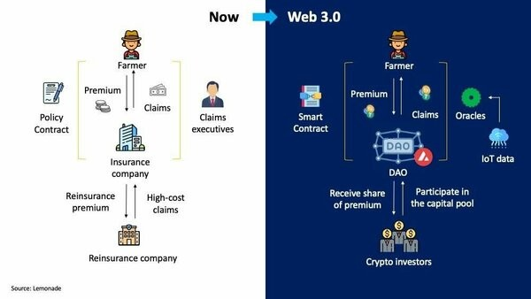
Typical insurance structure using DAO as a case study

Slide 14
THANK YOU

