Slide 1
Structuring Public Health to Promote Private Sector Growth
Presented by:
Samantha Weya
September 2023

Slide 2
Agenda
The Future of Public Health
Why do PPPs matter?
Why Should Actuaries Care?
Solutions for:
Informal Sector
Low Infrastructure
Expertise
Funding
The Role of Actuaries
Slide 2

Slide 3
The Future of Public Health
World Health Organisation (“WHO”):
Universal Health Coverage - a scenario where all people have access to the health services they need, when and where they need them, without financial hardship.
Seeks to achieve equity, efficiency and quality
“Global health 2035: a world converging within a generation,” vol. 382, 2013
SDG 3 by 2030?
Slide 3

Slide 4
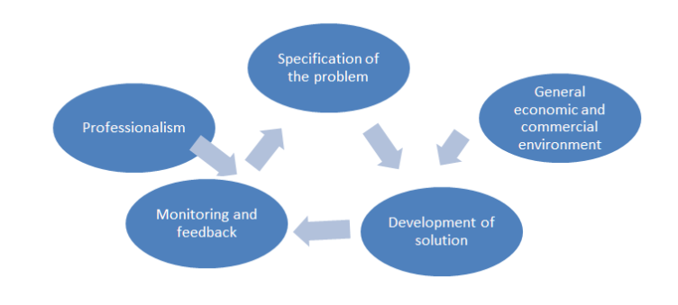
Why Should Actuaries Care?
Promote sustainability by asking the right questions, identifying the risks and their impact and creating mitigation strategies
Slide 4

Slide 5
Why Do PPPs Matter?
Funding
Expertise
Informal Sector
Low Infrastructure
The Politics of Healthcare
Slide 5

Slide 6
Social services: PPPs can be used to deliver social services such as healthcare, education, and water and sanitation.
Infrastructure: PPPs can be used to finance and develop a wide range of infrastructure projects, such as hospitals, roads and railways.
Agriculture: PPPs can be used to promote agricultural development and food security.
Manufacturing: PPPs can be used to attract foreign investment and promote manufacturing in Africa.
Why Do PPPs Matter?
The Opportunity
Slide 6

Slide 7
Improve access to care: PPPs can help to expand the reach of health services to underserved populations, such as those living in rural areas or in poverty.
Increase efficiency and effectiveness: Improve the quality and efficiency of health services
Promote innovation and investment: PPPs can encourage the private sector to invest in new technologies and services, and to develop innovative solutions to health challenges.
Why Do PPPs Matter?
Impact on Health
Lessons from the Index 1
Solidarity
Committed Leadership
Economic Growth
Meticulous Design
Slide 7

Slide 8
Infrastructure
Health infrastructure – not enough to meet needs and quality
Medical inflation – cost of care high with importation of medical technology and medication
Year | Nigeria | UK | Difference
1960 | 45,100,000 | 52,543,017 | (7,443,017)
2022 | 216,700,000 | 67,508,936 | 149,191,064
CAGR | 2.6% | 0.41% | 6.3 times
4/54
African Countries above WHO’s recommended
1:1000 Doctors: Population
Slide 8
Notes:
Per capita spend – developed nation at above 4k https://www.un.org/africarenewal/magazine/october-2020/public-financing-health-africa-when-15-elephant-not-15-chicken#:~:text=Currently%20African%20countries%20spend%20%248,countries%20that%20spend%20above%20%244%2C000
- The 4 countries meeting the WHO ratio of the number of doctors per 1000 are:
Mauritius 2.713
Seychelles 2.252
Algeria 1.719
Tunisia 1.303

Slide 9
The Private Sector Opportunity
Improving Access
Develop mobile health clinics that serve informal settlements
Provide healthcare services through community-based organizations that work with informal sector worker
Increasing Capacity:
Build hospitals and clinics e.g The Rwandan government
Pushing primary care to primary facilities - leverage technology like telemedicine
Regional manufacturing of tech and medication?
Educate doctors
Encouraging quality care
Create competition amongst providers – strong accreditation
Monitoring health outcomes and gains
Patients at the centre of patient care
In India, the state of Andhra Pradesh has partnered with a private company to deliver primary healthcare services to over 40 million people which reduced child mortality by 20%.
Slide 9
Notes:
Ghana: The Ghana National Health Insurance Scheme (NHIS) has partnered with private hospitals and clinics to provide care to its members. This has helped to increase access to care and improve the quality of services.
Rwanda: The Rwandan government has partnered with private companies to build and operate new hospitals and clinics. This has helped to expand the reach of health services and improve access to care for all Rwandans.
Kenya: The Kenyan government has partnered with private companies to provide HIV/AIDS treatment and care. This has helped to increase access to life-saving treatment and improve the quality of life for people living with HIV/AIDS.

Slide 10
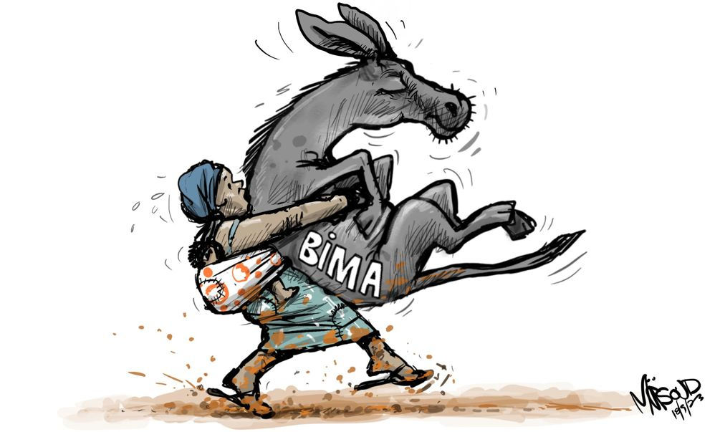
Informal Sector
Politics before economics
Big informal sector – over 80% so difficult to collect
Going to hospital leads to loss of income
Several unstructured groups
Volatility in incomes
Sustainable solution needs to be
Affordable
Accessible
Appropriate
Responsive
Simple
But economics still matters
Slide 10

Slide 11
The Private Sector Opportunity
Develop and deliver healthcare services that are tailored to the needs of the informal sector workers:
Develop mobile health clinics that serve informal settlements
Provide healthcare services through community-based organizations that work with informal sector workers.
Subsidize the cost of healthcare e.g. provide vouchers to informal sector workers that can be used to purchase healthcare services from private providers.
Public-private partnerships can be used to train and support informal sector workers to deliver healthcare services. For example, PPPs could be used to train informal sector workers to provide basic first aid or to distribute malaria nets.
Slide 11
Notes:
Per capita spend – developed nation at above 4k https://www.un.org/africarenewal/magazine/october-2020/public-financing-health-africa-when-15-elephant-not-15-chicken#:~:text=Currently%20African%20countries%20spend%20%248,countries%20that%20spend%20above%20%244%2C000
- The 4 countries meeting the WHO ratio of the number of doctors per 1000 are:
Mauritius 2.713
Seychelles 2.252
Algeria 1.719
Tunisia 1.303

Slide 12
Funding
Funding –$1,398 per capita spending at max efficiency would achieve UHC index of 80 but currently African nations at $8 to $129 per capita
Relatively small tax base
Out of Pocket expenditure is high
Rise of Non-communicable diseases
Absence of sufficient health data
Minimal population sensitization on preventative care and financial literacy
Slide 12
Notes:
Per capita spend – developed nation at above 4k https://www.un.org/africarenewal/magazine/october-2020/public-financing-health-africa-when-15-elephant-not-15-chicken#:~:text=Currently%20African%20countries%20spend%20%248,countries%20that%20spend%20above%20%244%2C000
- The 4 countries meeting the WHO ratio of the number of doctors per 1000 are:
Mauritius 2.713
Seychelles 2.252
Algeria 1.719
Tunisia 1.303

Slide 13
The Private Sector Opportunity
Premium Financing
Boost Private Sector to Boost Economic Growth and Generate More Revenue
Provision of loan facilities to pay for premiums
Subsidizing premiums for private insurance benefits
Who is purchasing what?
Substitutive: Substitutes for cover which would otherwise be available from the public health insurance system
Complementary: Complements coverage of publicly insured services or services within principal/substitute health insurance, by covering all or part of the residual costs (e.g. co-payments)
Supplementary: Covers additional health services not covered by the public scheme
Duplicative: Covers health services already covered under public health insurance, but with access to other, additional providers or levels of service, e.g. private health facilities
Slide 13
Notes:
United States: The Social Security Administration (SSA) offers a program called the Premium Support Initiative (PSI), which allows low-income individuals to finance their Medicare Part B premiums through a loan.
United Kingdom: The UK government offers a program called the Help to Save scheme, which provides low-income individuals with a government bonus on their savings.
South Africa: The South African GEMS program offers a premium financing option to low-income government employees. The premium financing option led to a 20% increase in enrollment in social security among low-income individuals.
the journal Social Science Quarterly
The study used data from a randomized controlled trial (RCT) to evaluate the impact of a premium financing program on social security enrollment in South Africa. The RCT was conducted between 2012 and 2014 and involved over 10,000 low-income individuals.
The study found that the premium financing program led to a 20% increase in enrollment in social security among low-income individuals. The study also found that the premium financing program did not have any negative impacts on other household spending.
The study's findings suggest that premium financing can be an effective way to increase access to social security for low-income individuals. The study's findings are particularly relevant for South Africa, where social security coverage is low.

Slide 14
Expertise
Viable - Funding
Feasible – Tech and Infrastructure
Key Determiners of Survival
What are the pain points?
Can they be solved?
Is the solution sustainable?
Where the magic happens
Desirable – Human
Slide 14

Slide 15
The Private Sector Opportunity
Strong Wings:
Balance the trip – promote solidarity (strong arms held out wide)
A Talented Pilot:
Leadership and Commitment
(The courage, resolve and leap)
A Brilliant Mechanic:
Designer System Controller – local context and suitable partnerships (a great jump master)
A Long Runway:
Admin Systems – managing members, providers and internal processes (the platform – just by the falls)
A Very Powerful Engine:
A good fiscal, regulatory and policy environment
- Promoting economic growth (a strong rope and reinforcement)
*The path to UHC lessons from Japan (by Professor Kenji Shimazaki)
Slide 15

Slide 16
Data Review
Claims analysis to assess key risks, cost drivers and trends
Profitability analysis
Assess impact of Management interventions (e.g. CDM and wellness)
Determine price and benefits using Actuarial techniques
The Private Sector Opportunity
Benefit Design
What are best practices and standard contribution rates?
Systems
Administration
Patient Records
Fraud analytics
Managing cost of claims:
Strong claims management processes – use of biometrics and clear validation processes
Fast claims settlement – increased efficiencies leave little room for fraud

Slide 17
The Private Sector Opportunity
Lessons learned from successful and unsuccessful PPPs:
It is important to have clear and well-defined goals for the PPP
The PPP should be structured in a way that is fair and equitable to both the public and private sectors
The PPP should be transparent and accountable to the public
The PPP should be monitored and evaluated regularly to ensure that it is meeting its goals
Slide 17

Slide 18
Samantha Weya:
sweya@zamara.co.ke
Diani Kenya

Slide 19
Any
Questions or
Comments

