Slide 1
Data Analytics Evolution
Kingsley Uzomba
Manager, Data Analytics Practice EY
Sanitized by Global Markets – EY Knowledge

Slide 2
Defining Data & Analytics
Data
Analytics
A piece of information.
Analytics is the extensive management and use of data, statistical and quantitative analysis, explanatory and predictive models and fact-based management to improve business performance, drive better business decisions and proactively manage risk.
Google’s definition
EY’s definition

Slide 3
The analytical process for decision making and taking action is quite similar to the way we react on instinct
Gather information
Absorb information from your surroundings and filter out what’s relevant.
Process information
Transform, combine and enrich information.
Model outcomes
Model patterns, imagine and analyse possible outcomes given available information.
Make decision
Consider the possible outcomes’ probability and decide the most rewarding action.
Take action!
The ultimate competitor for analytics is instinct (gut feeling).

Slide 4
A new generation of BI
Today, BI extends to everyone
3rd wave End user BI
Everyone
2nd wave Self-service BI
Analyst to end user
1st wave Technical BI
IT to end user
Notes:
Key message:
Business intelligence, or BI, has come a long way.
During the first two waves of business intelligence, IT professionals and business analysts were the keepers of BI. They made BI accessible and consumable for end users.
While this approach still applies to complex business intelligence needs, today there is a new wave.
This third wave of BI makes BI available to every kind of user.
Talking points:
Today we’re going to discuss Power BI, which is a third-wave solution. Power BI enables EVERYONE to collect, analyze, visualize and publish data.
This third wave has the potential to expand the reach of analytics to more users than ever before. Existing analytics platforms and tools can be extended, instead of being replaced, by full-featured solutions like Power BI. Power BI directly connects to existing on-premises data, such as Analysis Services tabular models that were created by business analysts in collaboration with IT. Microsoft Excel and the new Power BI Desktop work hand-in-hand with Power BI, publishing reports and models created by business analysts and getting them more easily in the hands of the business users who can gain insight and take action.

Slide 5
We divide Data & Analytics into Three capabilities
Data Visualization
Data Engineering
Data & Analytics
Data Science

Slide 6
Data Myth
Analytics
Statistic
Statistics

Slide 7
Analytics Evolution Landscape
Business Intelligence
Self Service Reporting
Data Science/ML/AI

Slide 8
Advanced Analytics Skill Set and Capabilities
Data Science
Programming
Statistical Computation
Domain Knowledge
Machine Learning

Slide 9
EY’s AI engagements drive revenue, improve efficiency or reduce risk
Revenue
Efficiency
Risk
1
Predicting advanced dormancy
4
Saving FTE with text analytics
7
Detecting CNP fraud
Utilising ML to improve customer interaction for Leading UK bank
67% accurate advanced dormancy prediction
Applied automated Text Analytics tool used to analyse text data in disparate sources at Leading UK bank.
4 FTE saved
Using predictive analytics to determine ‘card not present’ fraud detection
40% of total CNP Fraud for following 3 months were captured.
2
Improved customer churn prediction
5
Better next best action engine
8
More efficient DOL Compliance review
Using social network analytics to estimate Customer Churn at a Leading UK bank
16% improvement in estimation leading to proactive interventions
Next Best Action engine to better understand customer purchase patterns at Global bank
45% increase in prediction patterns
Automating DOL Compliance using NLP analytics model to identify fiduciary concerns for Leading UK bank
20X reduction in review time
3
Improving call centre analytics
6
Optimising customer searches
9
UDAAP Compliance
Deploy improved Call Centre Analytics compared to existing vendor solution at Tier 1 bank
$50-$100m reduction in running cost
Unsupervised clustering model to optimise customer search algos at Large Banking group
70% accurate classification
UDAAP Compliance for Global Tier 1 bank
+160% increase in detection
-7x in false positives

Slide 10
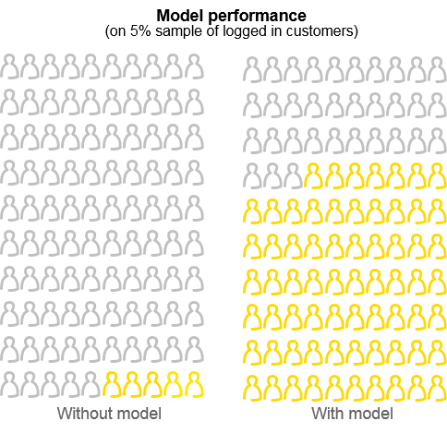
Predicting 30 day advance dormancy and enabling pro-active interventions
Revenue
Client challenge:
Disengagement from the internet bank, customers leaving the bank
Machine learning challenge:
Predict which customers are likely to become dormant in the next 3 months
Business outcome:
Accurate identification of 67% of dormant customers
Dormancy was predicted 30 days in advance
Model compared to a random 5% sample of customers who logged in over the last 30 days
Better ability to perform pro-active interventions
The model was able to be deployed in current bank systems
5%/67%
No model/Model

Slide 11
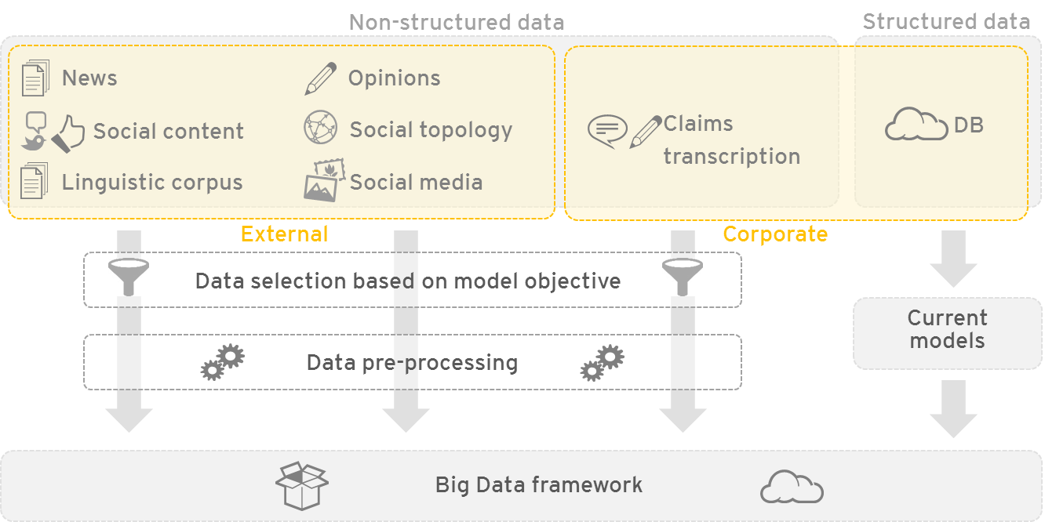
Improving churn risk estimation by 16% to identify ‘at risk’ customers
Revenue
Client challenge:
Churn model improved up to 16% on churn risk estimation against existing models
Identify causes for customer churn, where customers migrate to other institutions, identify ‘at risk’ customers, provide tailored products and improve customer experience
Industry: Banking
Issue: Churn prediction
Data source: Social media
Method: Social network analysis
Machine learning challenge:
Churn model beats at least 6% on churn risk estimation against existing models
Understanding existing customer base and uncover indicating signals. Provide real-time insight
Industry: Banking
Issue: Churn prediction
Data source: CDRs
Method: Social network analysis
Business outcome:
16% improvement on churn risk estimation
Churn prediction model up to 4 times more accurate than original system
Churn prediction model worked in real-time
Automated dash boarding to visualise churn drivers and trigger events
Successfully identified all ‘at risk’ customers to enable effective interventions

Slide 12
Advanced analytics (ML & AI) techniques enable multiple use cases
Supervised Learning
Fraud detection, credit risk/scoring, customer behaviour (e.g., churn), insurance underwriting
Unsupervised Learning
AML transaction monitoring, anomaly detection in cyber security
Predictive Analytics
Reinforcement Learning
Algorithmic trading
Deep Learning
Algorithmic trading, unstructured data processing (see below)
Social Network Analytics
Fraud and market abuse investigation
Machine Learning & Advanced Analytics
Descriptive & Prescriptive Analytics
Example use cases in Financial Services
Visualisation & Reporting
Sales & marketing, risk analysis, scheduling, resource allocation
Optical Character Recognition
Automation of paper-based processes (e.g., claims processing, accounts payable, trade finance)
Image
Authentication, insurance claims analysis
Unstructured Data Processing
Voice
Telephone surveillance (insider trading, etc.), voice sentiment analysis
Natural Language Processing
Email surveillance, Machine Translation, help systems/chatbots, report writing, contract review

