Slide 1
The Casualty Actuarial Society
Leading the way in General Insurance
Roosevelt Mosley, CAS President
21 September 2023
NAS Annual Industry Conference
Notes:
Thank you for the invitation to join you today. Unfortunately, I couldn’t be there in person today, but hope we can meet soon.
The CAS is pleased to have a growing relationship with the Nigerian Actuarial Society, and we look forward to increasing our connection as the actuarial profession continues to expand here.

Slide 2
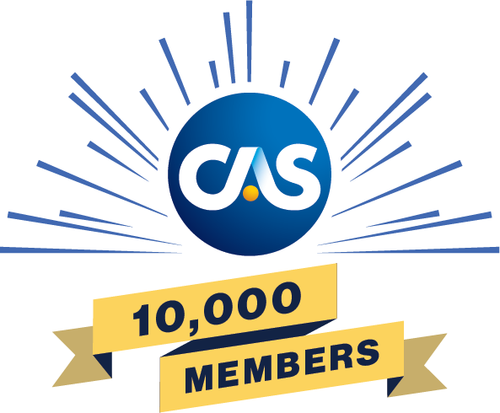
Introducing the CAS
World’s only actuarial organization focused exclusively on property/casualty credentialing, education, and research
100+ year track record in educating property/casualty actuaries, leading to ACAS and FCAS credentials
10,000+ members worldwide, and growing
Vibrant, growing community with deep and extensive resources to help CAS members, candidates, and students advance their careers
Ongoing support of the professional development of our members, with over 100 continuing education opportunities spanning over 340 hours offered annually

Slide 3
The CAS: Leading the Way in General Insurance
The CAS is the #1 choice for General Insurance actuaries in North America and beyond.
Why?
Exams develop skills that can be immediately and directly applied to the candidates’ daily work.
The CAS offers extensive opportunities for ongoing Professional Education.
CAS members form an engaged community of leaders in Property & Casualty experts practicing around the globe.

Slide 4
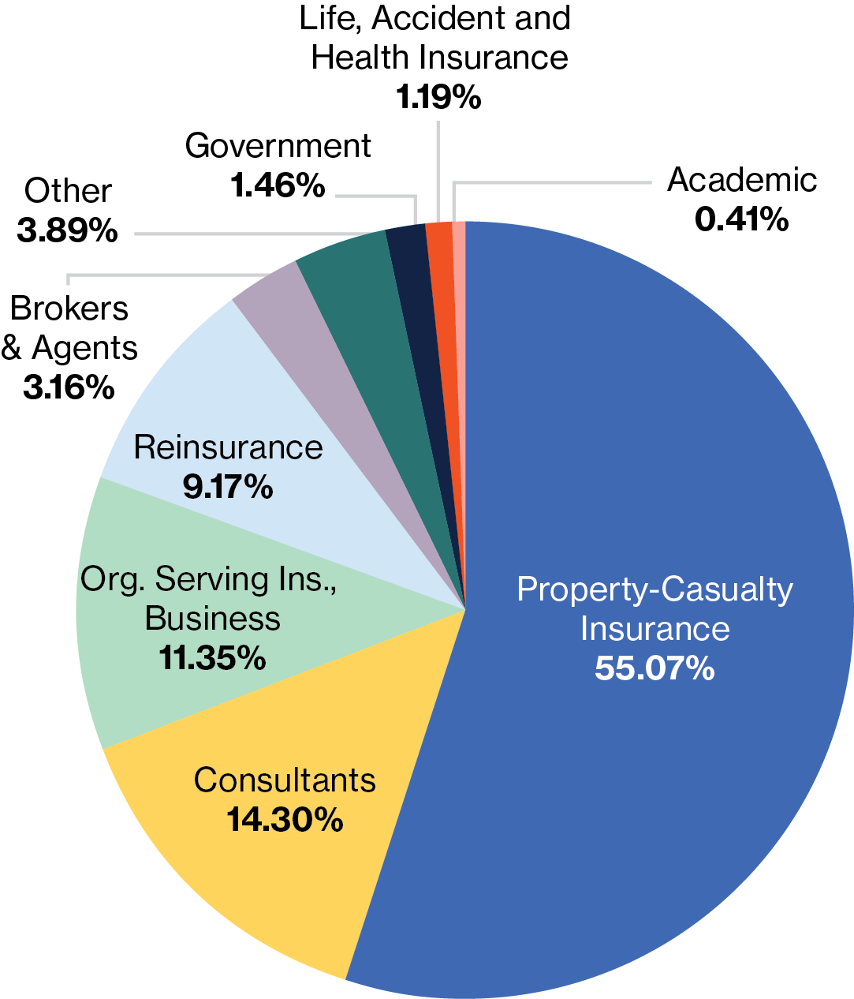
CAS Membership at a Glance
2012-2022 CAS Membership Growth
CAS Members by Type of Employment
FCAS ACAS Affiliate

Slide 5
A Global Actuarial Society
Members are located in 45 countries
Active candidates are located in 42 countries.
Approximately 70% of international members are located in Asia
This includes 29% located in China.

Slide 6
Basic Education

Slide 7
CAS Educational Journey 2023
Notes:
Note: This year, the CAS opened new test centers in Lagos, as well as Accra, Ghana – making the CAS credentials more accessible to West African actuaries.

Slide 8
Exam 6-International
Premiered in late 2021
What? Expand knowledge of international markets and provide practical information on various regulatory systems.
IFRS 17, Solvency II, Takaful (Islamic) regulation, regulations used in China
Why? To afford international candidates the opportunity to take an exam that more closely aligned with their day-to-day work.
When? Available every November exam sitting
How? Constructed response, 4.5 hour exam, given at Pearson Professional Centers globally

Slide 9
Exam Discount Program
Candidates in 100+ qualified countries can receive a discount of up to 80% off CAS exam registration fees and study materials.
Learn more at: casact.org/exams-admissions/exam-fee-discount-programs

Slide 10
Continuing Education

Slide 11
2023-2024 Calendar of CAS Signature Events
September 11-13, 2023: Casualty Loss Reserve Seminar
November 5-8, 2023: CAS Annual Meeting
March 18-20, 2024: Ratemaking, Product and Modeling Seminar and Workshops
May 2024: CAS Spring Meeting
June 3-4, 2024: Seminar on Reinsurance
Plus: at least 24 webinars annually covering a range of actuarial topics.
Notes:
Mention that they are hybrid events and include a virtual option.

Slide 12
CAS Capability Model
The CAS Capability Model is a visual framework that articulates and provides guidance on the traits, skills and knowledge important for most property/casualty actuaries.
For more information, visit: casact.org/professional-education/cas-capability-model

Slide 13
Research

Slide 14
Research
Casualty Actuarial Society E-Forum
Notes:
In addition to funded research, the CAS supports a number of volunteer-lead projects. Most of these find their way to the E-Forum, a non-refereed journal. Recently, the CAS has also published standalone “Research briefs” to address topics that are particularly timely.
Finally, the CAS maintains an organizational account on GitHub, a leading cloud-based collaboration platform. Project topics are anything from reserving methods, web scraping COVID-19 data, data visualization, or simply code which appears in a research paper. Users may download these code repositories, use them, and make suggestions for improvement.

Slide 15
Forthcoming Work
International Focus:
Actuarial Considerations Associated with IFRS-17 Implementation for General Insurers in Asia
Climate-related Actuarial Considerations for General Insurers in Asia, Africa, and/or Central and South America

Slide 16
University Programs

Slide 17
Supporting Future Actuaries
Resources For Students
Resources For Professors
Scholarships
Student Central Membership
Student Summer Programs
Academic Central Membership
Classroom Resources
Property & Casualty Research Library

Slide 18
Contact us!
For more information about:
CAS exams and credentials
CAS resources and research
University programs and scholarships
And more…
Contact international@casact.org

Slide 19
CAS Contact Information
Casualty Actuarial Society
4350 North Fairfax Drive, Suite 250
Arlington, Virginia 22203
casact.org/global

