Slide 1


United Nations Development Programme (UNDP)
Milliman Global Actuarial Initiative (GAIN)
Strengthening the actuarial profession in developing and emerging countries in order to promote economic stability and growth
Steve White
Henry Akwitti
21 September 2023

Slide 2
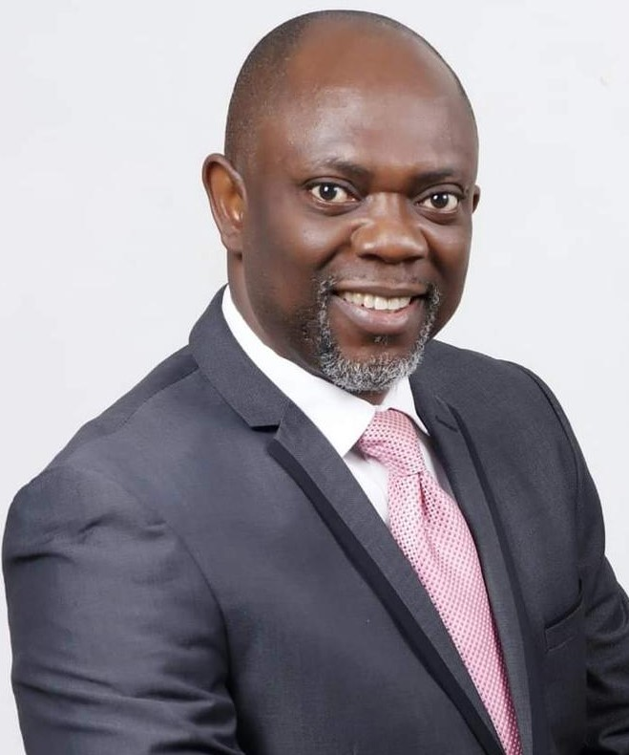
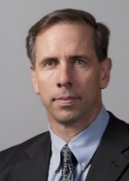
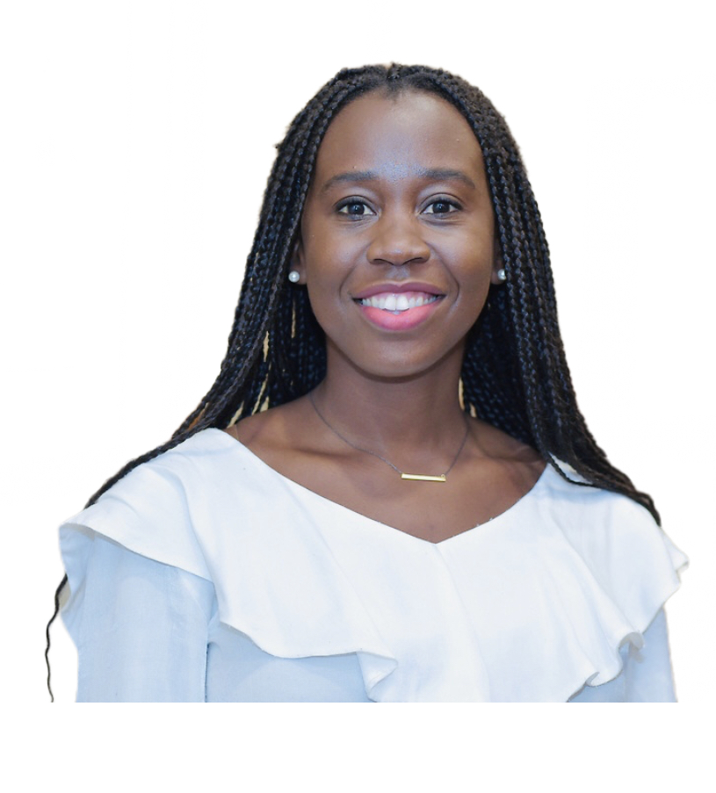
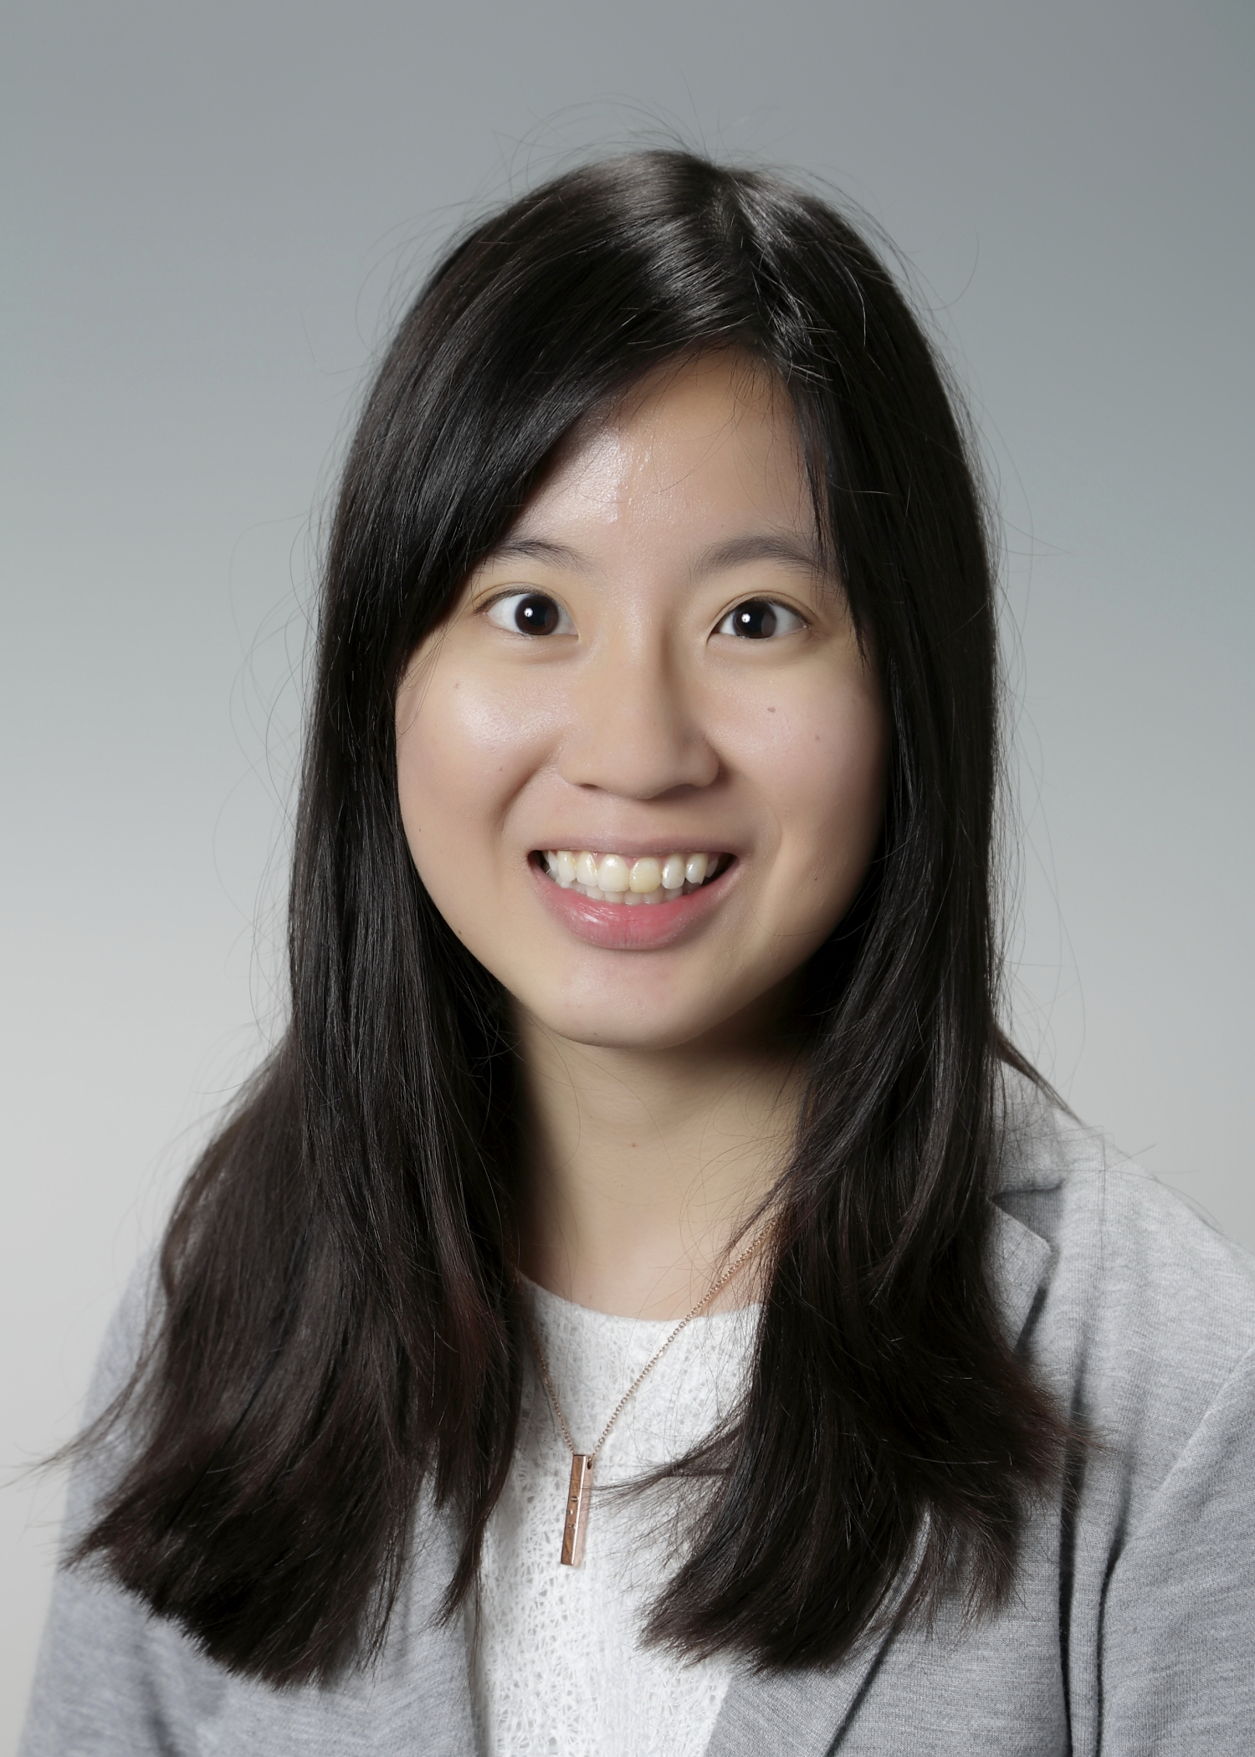
UNDP-Milliman GAIN team in Nigeria
UNIDP-Milliman Global Actuarial Initiative
Henry Akwitti
National Program Coordinator
Insurance and Risk Financing Facility, UNDP
Steve White, FSA, MAAA
Senior Consultant
Global Actuarial Initiative (GAIN)
Principal and Consulting Actuary,
Milliman
Armelle Otou
Program and Research Manager
Global Actuarial Initiative (GAIN)
Ong Xie, FIA, FSAS
Program Manager
Global Actuarial Initiative (GAIN)
Consulting Actuary,
Milliman
Notes:
All text is editable. Choose an icon which works with content, or delete.

Slide 3

Introduction of UNDP
UNIDP-Milliman Global Actuarial Initiative
The UNDP works with developing countries across the globe
to eradicate poverty and reduce inequality.
1
Sustainable development
2
Democratic governance and peace building
3
Climate and disaster resilience
Notes:
The UNDP works with developing countries across the globe to eradicate poverty and reduce inequality.
Their work is focused on sustainable development, democratic governance and peace building, and climate and disaster resilience.
In recent years the UNDP has more broadly recognized the importance of risk management and its link to sustainable development.
For any society to develop economically, people must be able to save and invest, and they must have resources to manage risk.

Slide 4
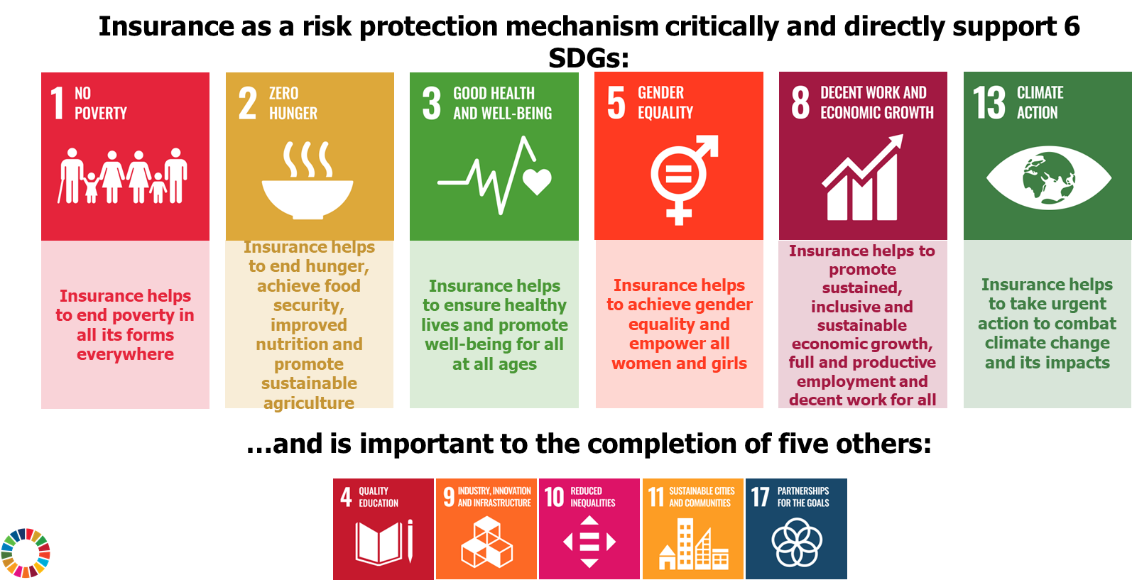
Insurance contribution to the Sustainable Development Goals (SDGs)
UNIDP-Milliman Global Actuarial Initiative
Insurance as a risk protection mechanism critical and directly supports 6 SDGs:
Notes:
All text is editable. Choose an icon which works with content, or delete.

Slide 5
UNDP Insurance & Risk Finance Facility (IRFF)
UNIDP-Milliman Global Actuarial Initiative
Notes:
All text is editable. Choose an icon which works with content, or delete.

Slide 6
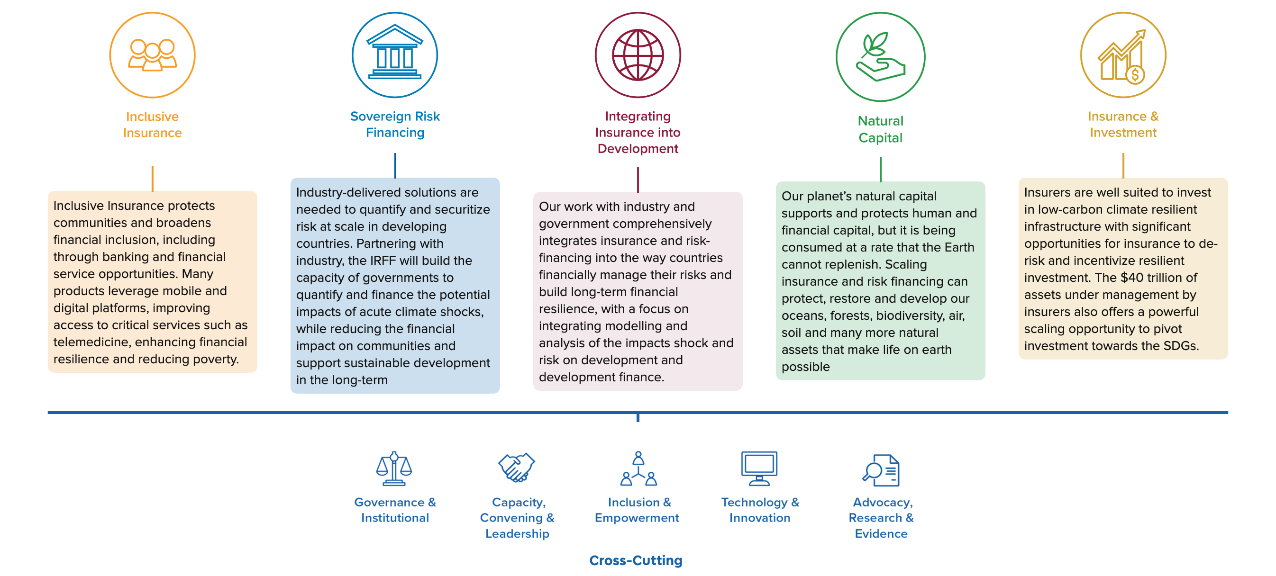
UNDP Insurance & Risk Finance Facility (IRFF)
UNIDP-Milliman Global Actuarial Initiative
The workstreams
Notes:
Our corporate headquarters are in Seattle, Washington.

Slide 7
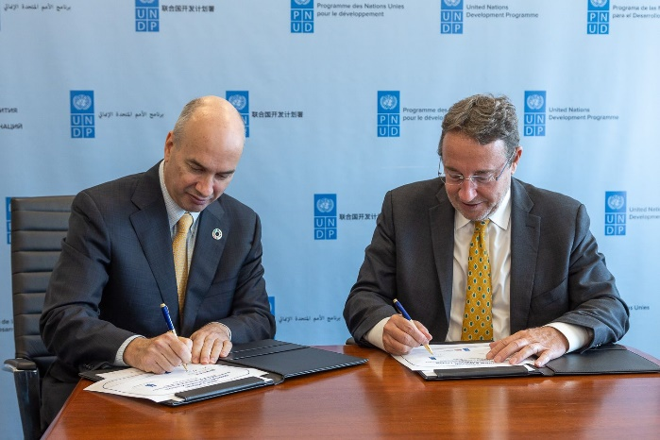
Milliman-UNDP Partnership: Global Actuarial Insurance Initiative (GAIN)
UNIDP-Milliman Global Actuarial Initiative
Program Launch – 18th September 2022
“Protection from risks is the only way out of a world of deepening inequalities and compounding crises.”
“Our collaboration with Milliman should generate the expertise necessary to support insurers and regulators as they look to effectively address these risks.”
UNDP Administrator Achim Steiner
Notes:
3min

Slide 8
Actuarial contribution to the Sustainable Development Goals (SDGs)
UNIDP-Milliman Global Actuarial Initiative
Better functioning insurance markets and risk management
Develop and price risk-responsive and inclusive insurance
Affordable insurance solutions for poor and vulnerable people
Growth of actuarial profession
Stimulate and incentivize growth by stripping away uncertainty and risk
Allow families and governments to invest more with the knowledge that their critical assets are well protected
Build financial resilience, protect development gains and sustain better lives
Notes:
All text is editable. Choose an icon which works with content, or delete.

Slide 9
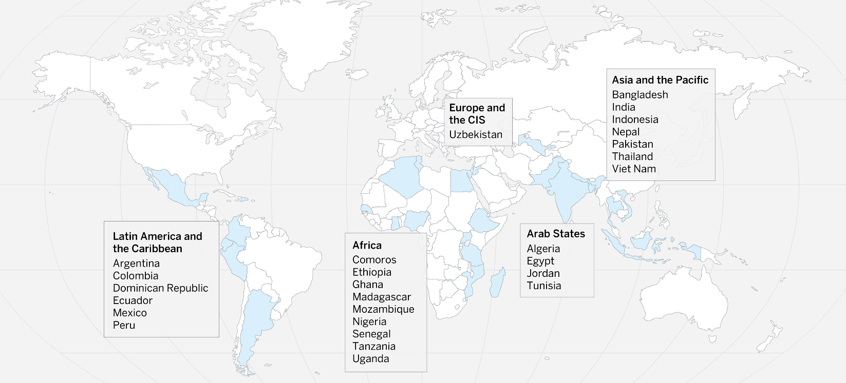
Implementation across 27 countries
UNIDP-Milliman Global Actuarial Initiative

Slide 10
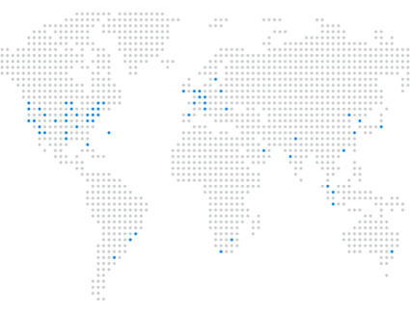
About Milliman
UNIDP-Milliman Global Actuarial Initiative
Providing cutting-edge consulting advice – wherever our clients do business.
Global Leader
Experienced
1947
Our founding year
64
Offices Worldwide
4,600+
Company Employees
Innovative
Innovation is key to continuously providing the best solutions for our clients.
Trusted
3,000+
Actuarial & consulting clients
44 of the top 50
insurers globally engage our services
Social impact
  Social responsibility is embedded in everything we do—how we work with clients, hire and develop our people, and interact with our communities.
Notes:
3 minute warning
About half of the 4,600 employees are actuaries
Consulting and products
Merideth

Slide 11

Our Mission
UNIDP-Milliman Global Actuarial Initiative
To serve our clients to protect the health
and financial well-being of people everywhere.
Notes:
About half of the 4,600 employees are actuaries
Consulting and products
Merideth

Slide 12
Overarching goals of GAIN
UNIDP-Milliman Global Actuarial Initiative
Program Goal
Partnership Goal
Enhance global sustainable development through enhancement of the actuarial profession in the developing world.
Milliman will work within the UNDP target countries, and with other stakeholders, to advance the program goal as part of a full spectrum of interventions in eradicating poverty.
Notes:
3min

Slide 13
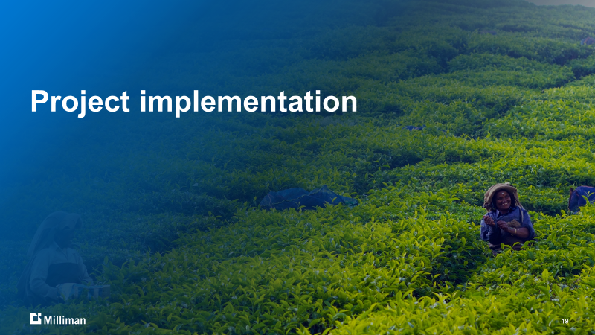
Project implementation

Slide 14


Actuarial situation assessment
UNIDP-Milliman Global Actuarial Initiative
Pillars of success
Thought leadership,
professional development &
networking
Public policy & regulation
Educational pathway
(Supply)
Employment opportunities (Demand)
Expertise in climate risk
Data quality & accessibility

Slide 15
Key stakeholders
UNIDP-Milliman Global Actuarial Initiative
Academic institutions
Insurance companies
Regulator
Local actuarial associations
UNDP Country Offices
Training institutions
Insurance associations in country
Disaster risk financing authority
Global actuarial associations
UNDP IRFF
Social Security and Pension Systems
International Actuarial Association (IAA)
Notes:
Our corporate headquarters are in Seattle, Washington.

Slide 16







Key steps
UNIDP-Milliman Global Actuarial Initiative
  1. Preparation for in-country
      Contact in-country stakeholders
      Set up meetings
  2. Assessment Trip
      5-10 days in-country visit
      Roadmap working session across all stakeholders
  3. Establish working group
      Bi-monthly meetings
      Appointed chair and secretariat
  4. Execution of roadmap
      Implement intervention plans
      In-person weeklong assignments
      Virtual short-term projects
  5. Ambassador mission/work
      Recruit volunteers
      Prepare volunteers for work in line with roadmap
  6. Monitoring and evaluation
      Working group oversight
      Feedback from ambassador and local stakeholders

Slide 17


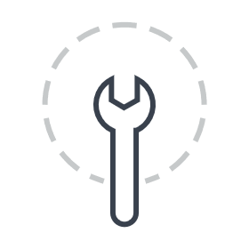





Program activities
UNIDP-Milliman Global Actuarial Initiative
Capacity
    Enhancing the actuarial profession in the target countries
    How: By working with the supply side - associations, universities, actuaries – and the demand side - supervisory authorities, insurance industry and public sector players
Advocacy
    Supporting advocacy to governments, insurers and others in achieving the goal of an enhanced actuarial profession.
Data
    Enhancing data availability and effective utilization
    How: Through regulators and the insurance industry and well as data “owners” like meteorological agencies and statistics offices
Climate risks
    Supporting countries in adapting with more resilient risk management to help mitigate financial impacts of climate change
    How: By improving the meteorological risk modelling and associated liability valuation.

Slide 18
GAIN intervention activities to date
UNIDP-Milliman Global Actuarial Initiative
Exam tutorials
Training on actuarial technical topics
Microinsurance Pricing Toolkit
Mentorship program
Support to university actuarial programs
Develop climate map of risks
Development of best practice guidelines for setting up actuarial teams
Actuarial Profession Awareness Toolkit
Review of regulatory definition of actuaries
Webinar on actuarial skillsets and value of actuaries
Capacity building at regulator’s office
Support for developing legal framework for the actuarial profession

Slide 19
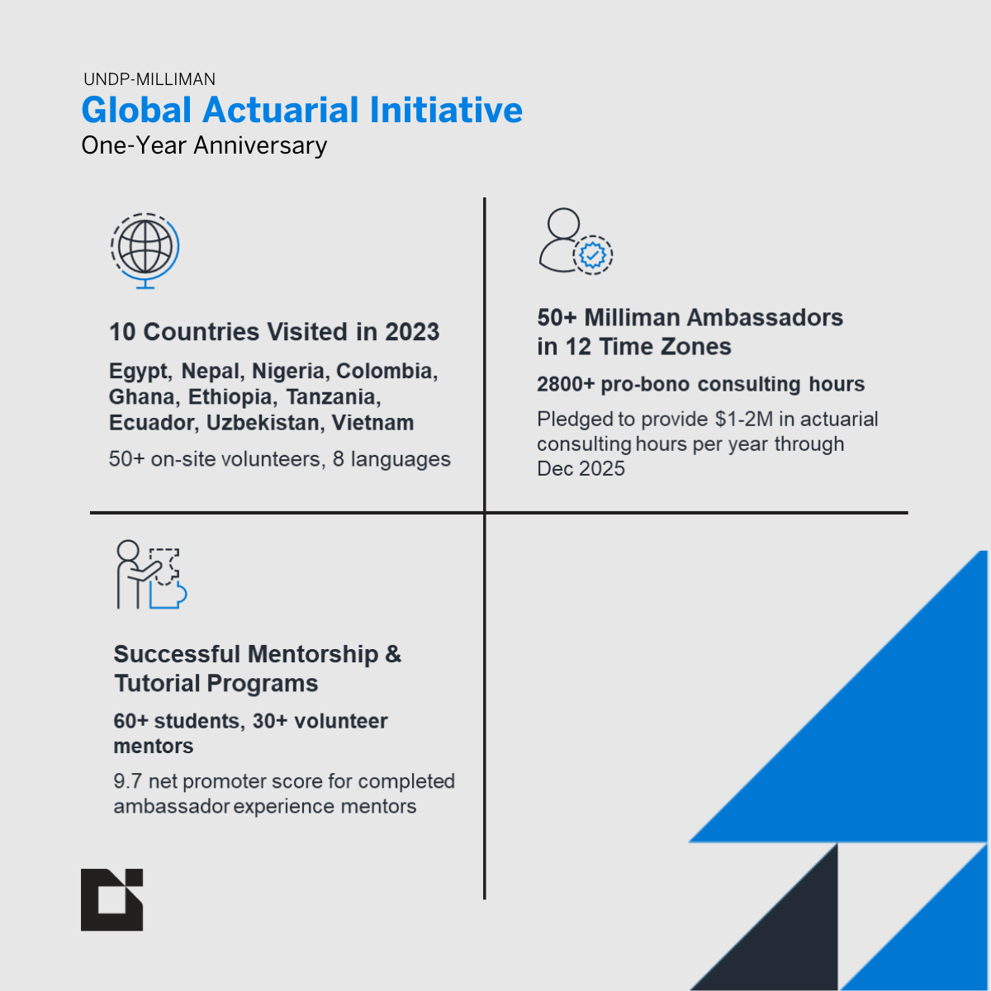
What have we been up to so far?
UNIDP-Milliman Global Actuarial Initiative

Slide 20
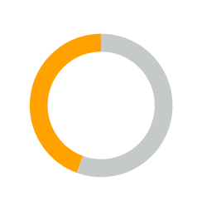

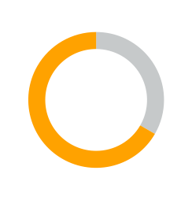
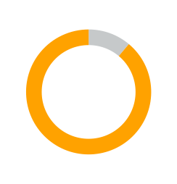
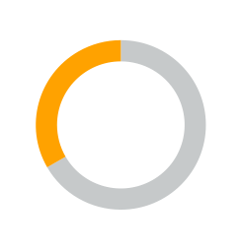
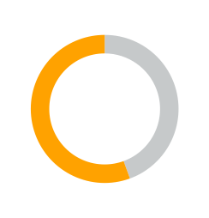
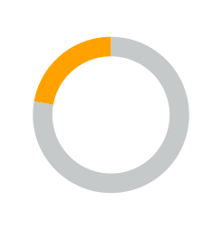
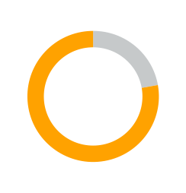
What’s next for us for the next 2 to 4 years?
UNIDP-Milliman Global Actuarial Initiative
Support promotion of actuarial profession
Expansion of mentorship opportunities
Growing the actuarial profession through education
More capacity building trainings
Development of more tools to support growth of actuarial capabilities
Support advocacy on value of actuarial expertise
Build structures for a facilitative working environment
Continue collaboration with key actuarial professional bodies

Slide 21
Our progress in Nigeria

Slide 22
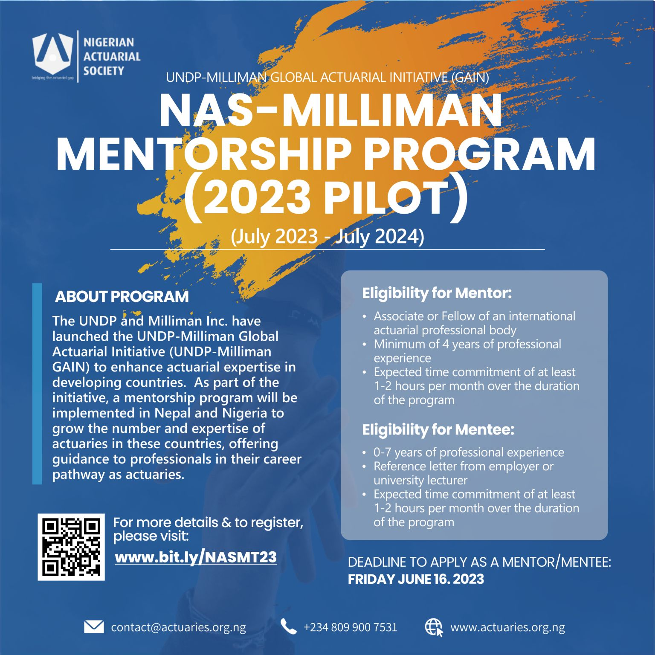
Mentorship Program
UNIDP-Milliman Global Actuarial Initiative
Mentorship Program launched in July 2023
One-year program involving 70+ participants
16 pairings from Nigeria, involving 7 mentors from NAS and 9 mentors from Milliman / other actuarial associations
To provide career support and guidance to actuarial professionals equipping them with greater understanding of their career pathway as an actuaries

Slide 23
Exam Tutorials
UNIDP-Milliman Global Actuarial Initiative
Exam P tutorial with UNILAG students
Virtual tutorial for IFoA Exam CS2
Pilot program in collaboration with NAS and UNILAG
Two Milliman ambassadors visited Nigeria for one week to run in-person revision classes to students
Tutorial program run by two Milliman ambassadors from our Mumbai office
Participated by 5 students from Nigeria

Slide 24

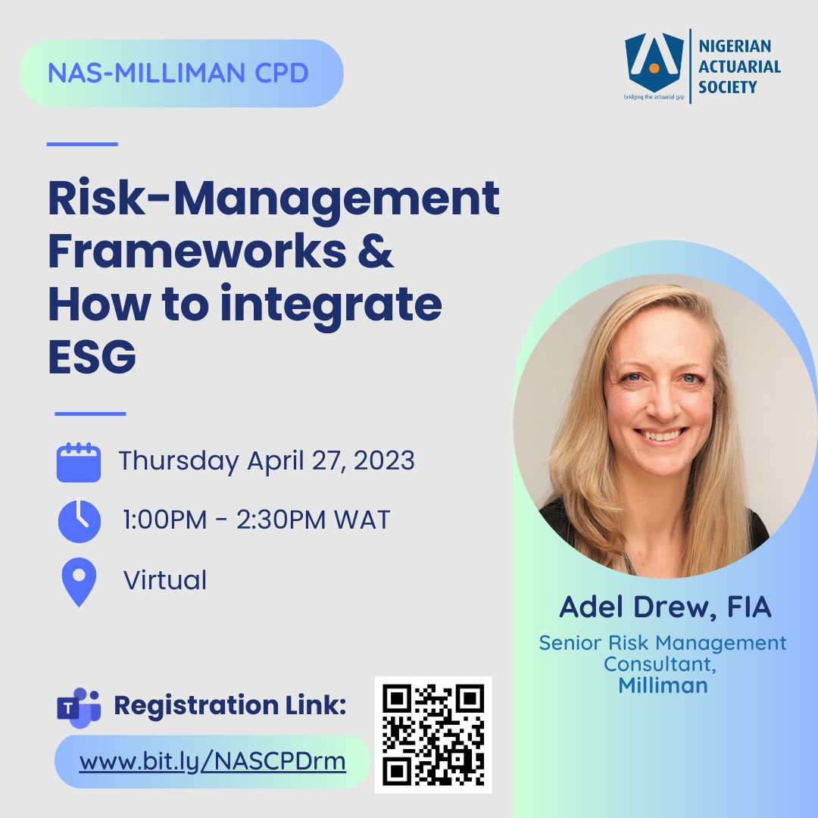
Actuarial Bill review and virtual CPD
UNIDP-Milliman Global Actuarial Initiative
A Milliman ambassador provided review of the draft Actuarial Charter Bill from the professional standpoint of an actuary.
Actuarial Bill Review
Through GAIN, we also hosted a virtual CPD session jointly with NAS on the topic “Risk Management Frameworks & How to integrate ESG”.
Virtual CPD

Slide 25
Planned Nigeria intervention activities – with focus on sustained progress
UNIDP-Milliman Global Actuarial Initiative
Strengthening universities
Connecting university students with NAS
Focusing the curriculum to prepare students for the exams and work
Training for actuarial educators
Support to actuaries
Continuing mentorship program
Guidance from experts on specific topics
Providing access to affordable tools and resources
Promotion of the actuarial profession
Capacity building across insurers
Actions by insurers to hire actuaries and support them in their career
Seminars on role and benefits of hiring actuaries
Best practices on setting up an actuarial department
Support from regulator for actuarial capacity
Requirements for actuarial capacity among insurers
Increase in actuarial capacity within regulator`

Slide 26
Questions
& Answers

Slide 27
Thank you

