Slide 1


Inclusive Insurance, a myth or reality
2023
FSD Africa
Lagos, Nigeria
Elias Omondi
Principal, Innovation of Resilience

Slide 2

The Protection Gap in Africa
The protection gap in Africa is deep, and persistent; uninsured losses force painful choices on African families
Insurance penetration as percent GDP
Insurance penetration per capita
Weak demand
-50%
Inconsistent public budgeting
-11X
Coping mechanisms for the uninsured can push families further into poverty
Africa
Average
World Average
Africa
Average
World Average
Lack of data and models

Slide 3
Challenges in the risk transfer market
Low resilience for households, businesses and governments due to weak demand for, and low-quality supply of risk solutions, plus restrictive enabling environments that impacts risk across markets
Insurance market
Micro
Meso
Macro
Lack of awareness and understanding of sustainable financial solutions
Weak demand
Affordability
Informality
Inconsistent public budgeting
Distrust
Poor understanding of risk
Challenges
Lack of expertise to develop sustainable innovative solutions
Low-quality supply
Low margins
Lack of data
Lack of data and models
Ineffective market reach
Lack of aggregators
Unattractive risk/return profile
Restrictive enabling environment

Slide 4
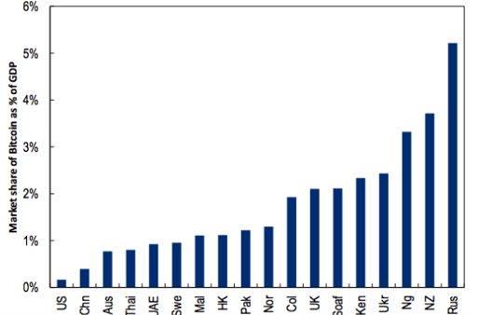
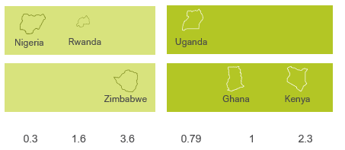
More Complex than Cryptocurrency?
Insurance penetration is lower than the cryptocurrency market share

Slide 5
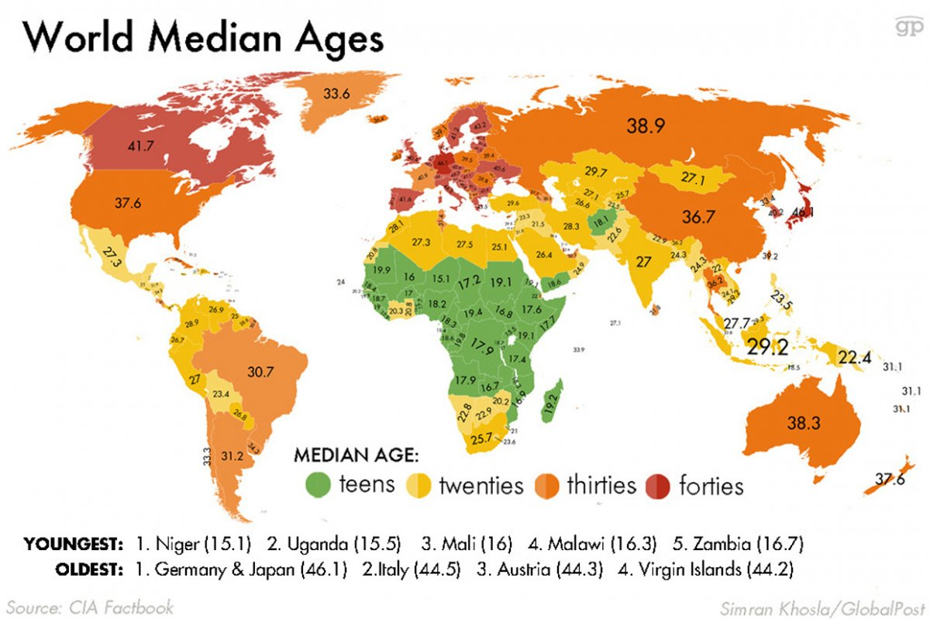
Or Both

Slide 6
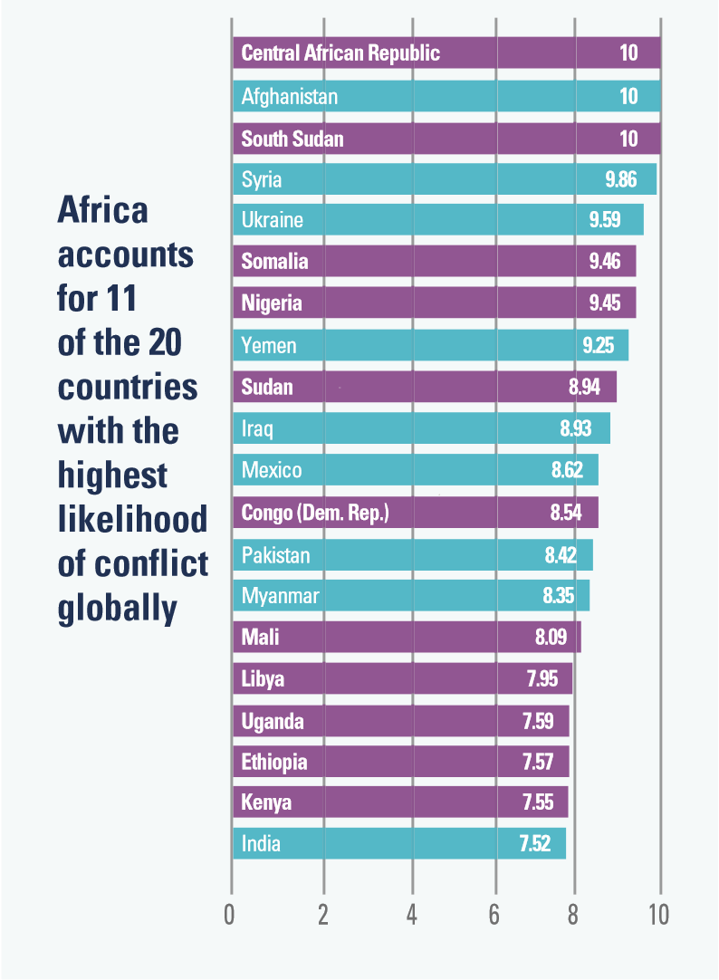
Africa: Political Risk
Insurance can be used as a social safety net
Political Risk is still a reality in Africa
Insurance can play a role in reduction of poverty and instability
Insurable risk with well thought out risk mitigation measures can create an opportunity.
Source: UNDP, 2017

Slide 7

Data
Automation requires data
Predictive Underwriting requires data.
Pricing requires data
Automated Claims Processing requires data
  WHO’S DATA IS IT?

Slide 8
Africa’s opportunity
The region is estimated to have a population of 1.34 billion people, which is forecast to jump to 1.87 billion by 2035 and 2.48 billion by 2050, according to Statista.
By the year 2050, the UN estimates that Africa will have 945 million people under the age of 25.
Africa has the biggest pool of tech-savvy young people on the globe, making up almost twice the young population of South Asia and Southeast Asia, East Asia and the Pacific region combined
In 2020, the number of registered mobile money accounts in the SSA region reached 548 million – up 12% on the previous year – representing almost half of the 1.2 billion accounts worldwide
Notes:
Our role in Africa is to be a shock absorber for our clients, so we can build the societal resilience needed to close the protection gap. The Swiss Re Institute estimates that, globally, about 66% of all-natural catastrophe economic losses over the past 10 years were not insured; in Africa, this protection gap is even higher. You may recall Cyclone Idai led to an overall economic loss of USD 2 billion across Mozambique, Malawi and Zimbabwe, of which only 7% was insured; a staggering 93% protection gap. Our primary objective in Africa is to address this immense protection gap to make Africa more resilient.

Slide 9
Collaboration on Data
Insurers need to work together
Insurer’s need to collaborate and create an Africa wide Data Pool
Working with Government on access to new large data pools
  Universal Healthcare
  National Social Security
  Satellite Data (Agriculture)

Slide 10


SOCCER CHANGING TO FOOTBALL – THE STORY OF INSURTECH’S

Slide 11
Average age of an insurance agent is increasing
We have abundant data
Backend technology of incumbents are still poor
Customer expectations are always changing
THE INSURTECH SPACE

Slide 12
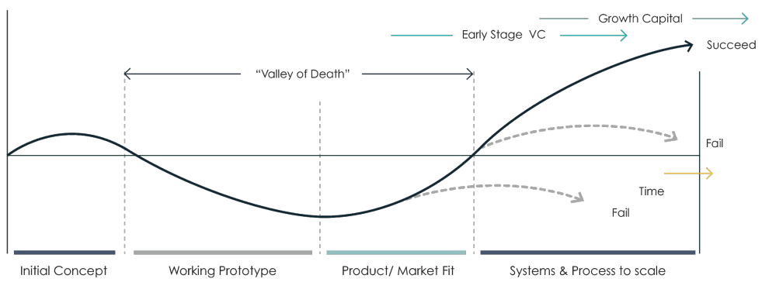
“Valley of Death”
Technical capacity, access to funding, access to strategic partnerships, and regulatory barriers

Slide 13







Innovation ecosystem enablers
Over 80% have access to Mobile Phones in developing countries
A strong talent pipeline to spur innovation in incumbents and form innovative start-ups
Underlying infrastructure to enhance market efficiency, including electricity, access to mobile phones and adequately priced digital connectivity
19 Well-Known Insurtech Accelerators and Incubators
``````
Market engagement enablers: a digitally and financially literate population who is ready to take up innovation; availability of appropriate and ready aggregators/distribution partners, underwriting partners or tech partners
73 unique fintech sandboxes in 57 countries.
An enabling, test-and learn regulatory environment
33 percent of adults worldwide are financially literate
Supervisory support for innovators/new market entrants, including transparent and timely licensing processes, soft guidance and facilitating collaboration between tech innovators and the incumbent market players
Access to finance for innovators throughout the development lifecycle of the firm, as well as for new innovative ventures among incumbents
$19.8bn in capital during 2021.
JULY 2022

Slide 14



Consumer protection and emerging regulatory requirements
Innovation is key to increasing insurance penetration
Changing this trajectory requires innovation supported by a conducive innovative ecosystem
Acting on this mandate means taking stock of the challenges to innovation and wielding the full suite of tools at the regulator’s disposal to support innovation.
However, insurance regulators need to strike a balance between fostering an enabling environment for innovations, while protecting the market against undue risks associated with market development.
Regulator’s role important for innovation: More regulators globally have a market development mandate and to act on this, they need to:
Regulate responsibly
Promote market development:
proactively engage, encourage and support innovation
Ensure protection:
assessing innovation risk and regulatory gaps that could harm consumers

Slide 15



Next Frontier
  CONNECT
  Attract, inspire, and organize key players and disruptors across the financial industry and technologies to collaborate on ground-breaking, innovative insurance products and services.
Data
Product Development
  CREATE
  Stimulate industry collaboration, product development and strategic partnerships.
Enabling Environment
  SCALE
  Fuel growth through connections by building investor linkages.
Sustainable Future
Notes:
• Gender bond released investing in products for women – how is it transforming the landscape in Tz
• Volume – risk pooling and pricing – Scaling and seasonality of the malaria insurance (one month a year) how did you manage?

Slide 16
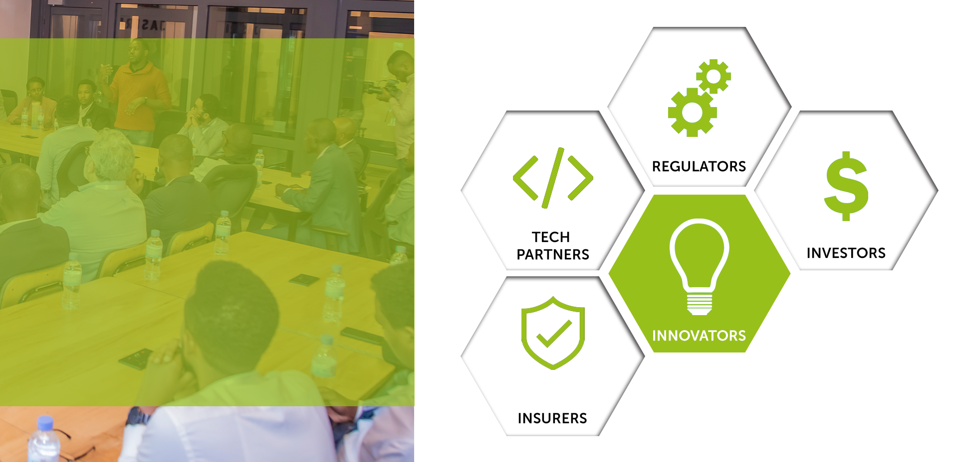
BimaLab
Acceleration
Ecosystem
BimaLab Accelerator is set to address challenges that innovators are facing such as lack of technical capacity, access to funding, access to strategic partnerships, and regulatory barriers.

Slide 17

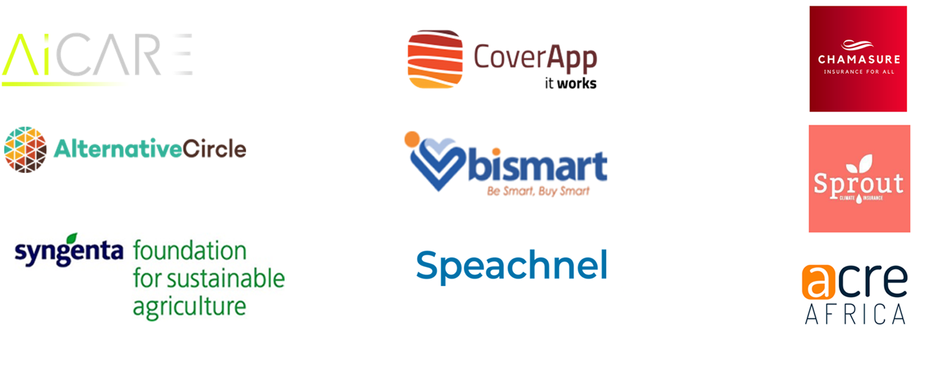
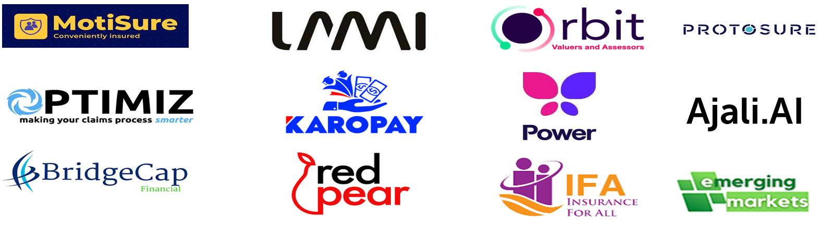



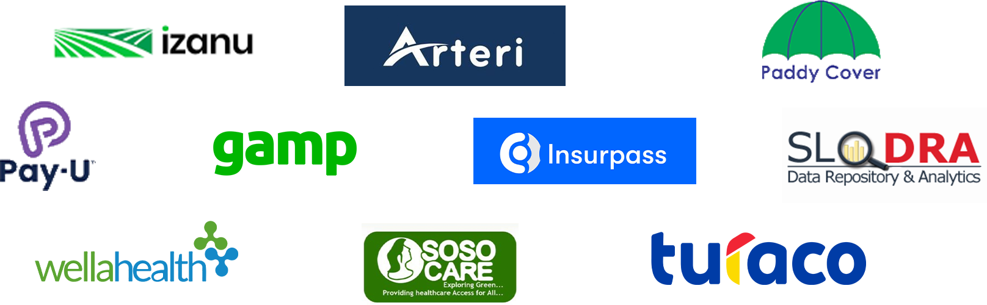
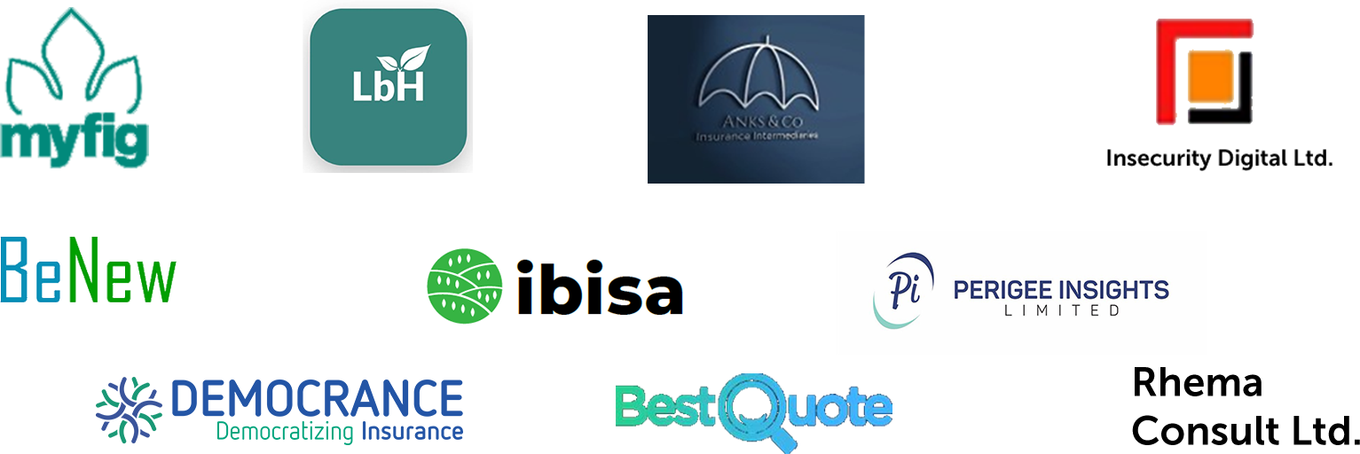
BIMALAB INSURTECH ACCELERATOR PROGRAMME
BimaLab Journey
2020: Kenya – BimaLab Launched, 9 Ventures Accelerated
2021: Kenya – Second BimaLab Cohort , 12 Ventures Accelerated
2022: Nigeria –BimaLab expanded to West Africa, 10 Ventures Accelerated
2022: Ghana –BimaLab expanded to West Africa, 10 Ventures Accelerated

Slide 18






BIMALAB INSURTECH ACCELERATOR PROGRAMME
Outsized Success 2020-2022:
Results of our acceleration model - BimaLab has a strong track record of accelerating, investing and building startups in Africa
42
Innovative products and services developed
Over
customers reached
1million
40
raised
by the
ventures
Over
partnerships with insurance industry
Over
3
Africa awards
20
$3 million
insurtechs accelerated
*All the 40 Insurtechs have commenced their business operations in the continent
Over
investors have supported the ventures
3
Sandboxes authorised and issued
10

Slide 19

BimaLab Success Stories and Impact
2020 - CoverApp of Kenya won the African InsurTech of the Year award with an android application that is found on Google playstore and operates as a web-based application
2022 - Lami Technologies secured a US$ 3.7 Million seed extension to expand across Africa
2022 - SOSO CARE wins Africa Innovation of the Year award with product which is geared towards cleaning the environment by linking the collection of trash to recycle to finance micro-health insurance
2023 – Turaco that provides simple and affordable insurance solutions for emerging markets passes one million customers insured
2023 – BeNew Insurance won the African InsurTech of the Year award with unique payment solution for premium and claims via an electronic wallet
2023 – Gamp announced its partnership with one of Nigeria’s leading insurance company, Leadway Assurance, to deliver Africa’s first insurance, after-sales support, and repair services for devices in Nigeria wallet
2023 – National Insurance Commission (NAICOM) released the insurance regulatory sandbox operational guideline to deepen insurance penetration and financial inclusion through innovation in Nigeria

Slide 20
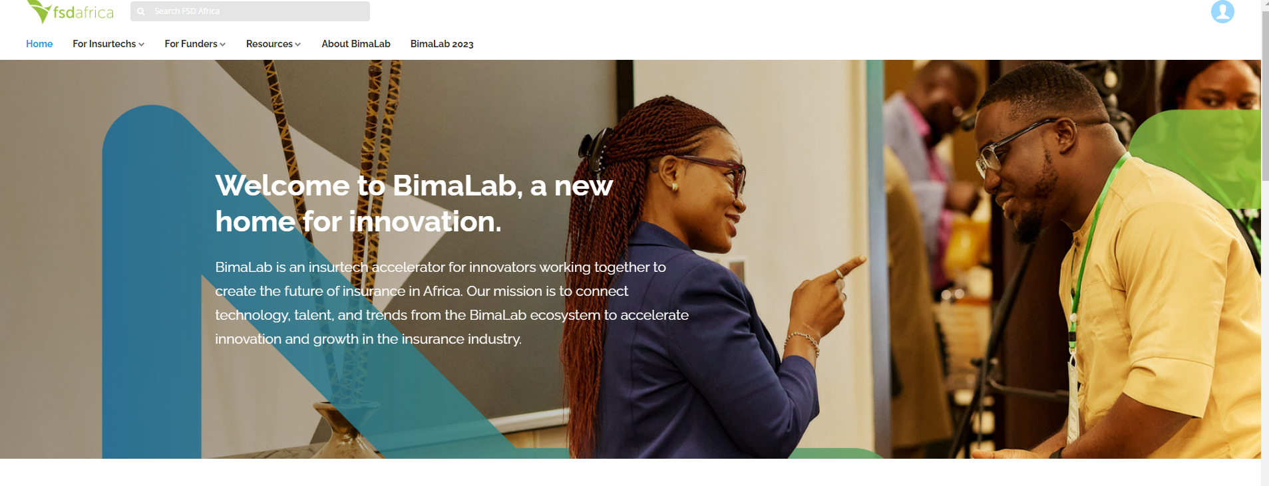
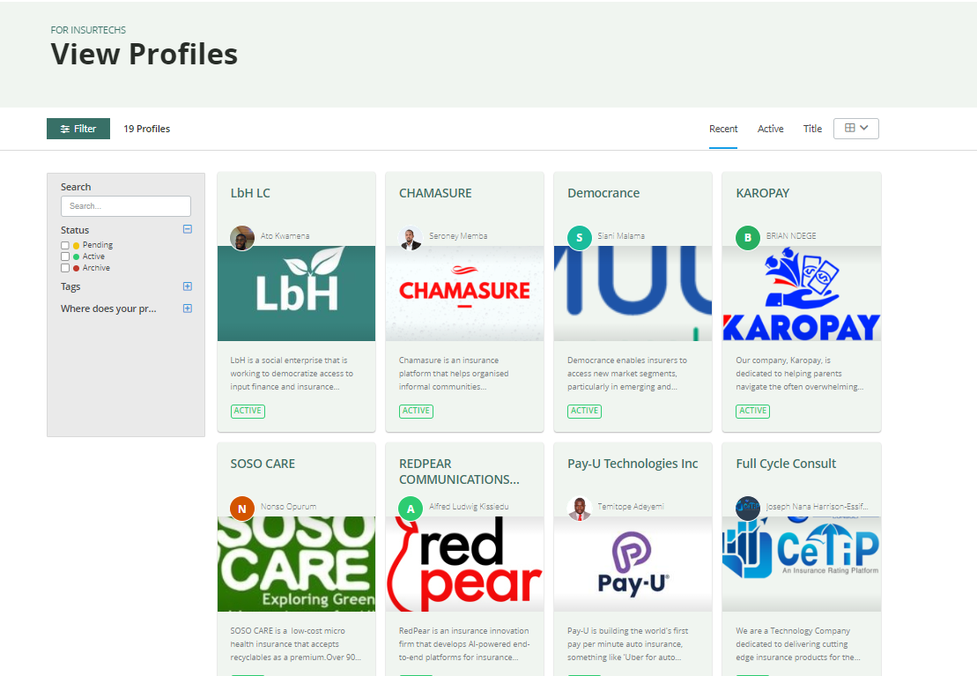
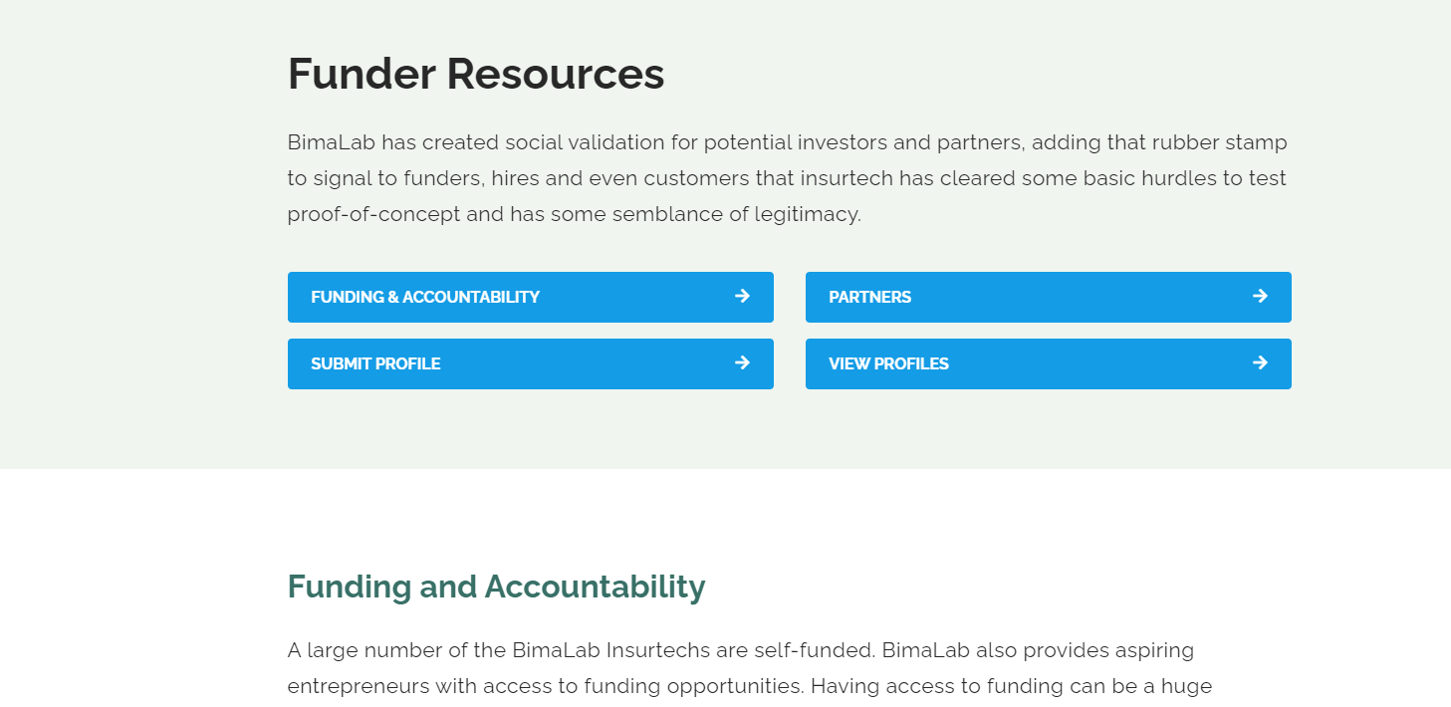
BIMALAB ACCELERATOR PROGRAMME
BimaLab Digital Platform
We have built a digital platform that brings together innovators, funders, insurance companies, regulators:
https://bimalab.org/

Slide 21

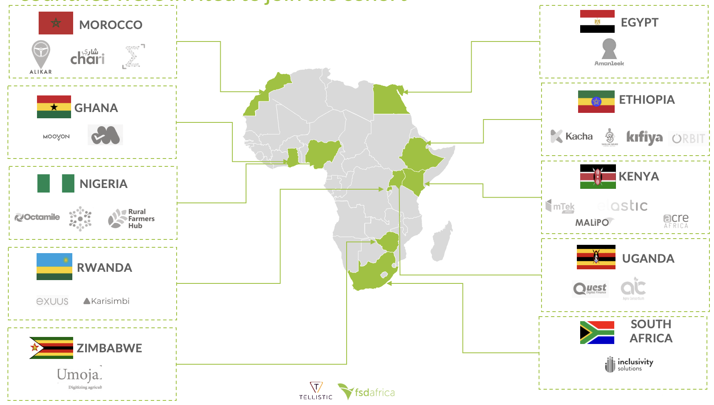








BIMALAB ACCELERATOR PROGRAMME
Current BimaLab Africa Status - 2023
23 ventures, 10 Countries, 9 Regulators

Slide 22
Elias Omondi
elias@fsdafrica.org

