Slide 1
‘The time is now’
Sustainability: Managing Climate & Related Risks
The role of actuaries in helping tackle climate change
NAS Conference – 21st September 2023
Mukami Njeru
IFoA Council Member
Mukami Njeru PwC | Head Actuarial and Insurance Management Services
West Market Area

Slide 2
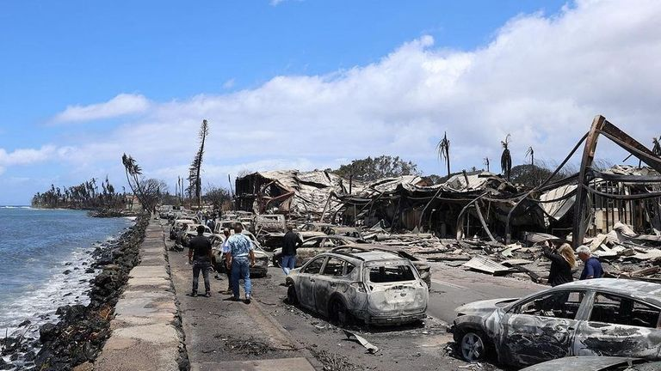
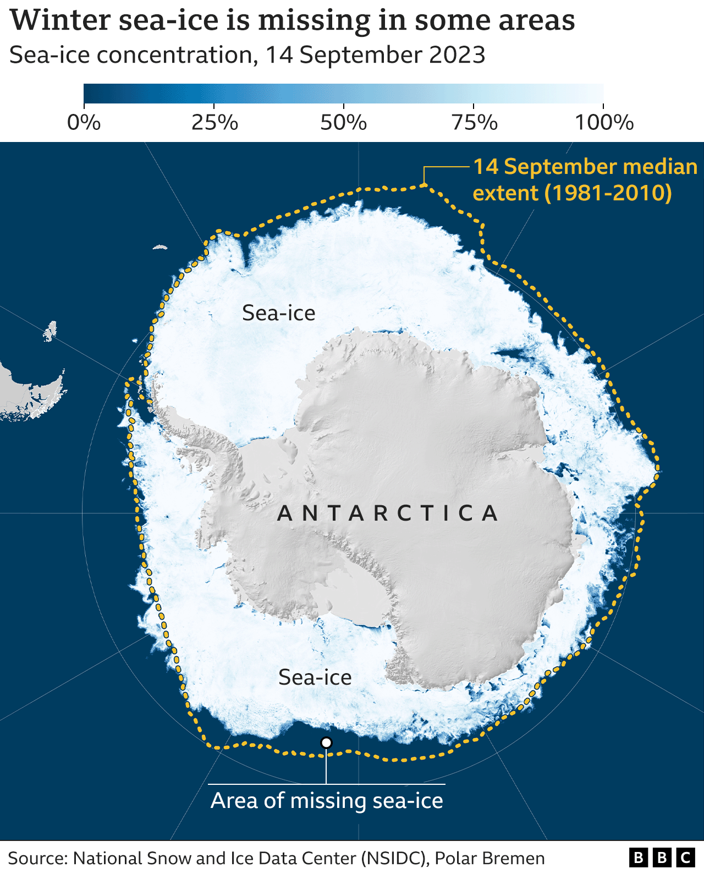
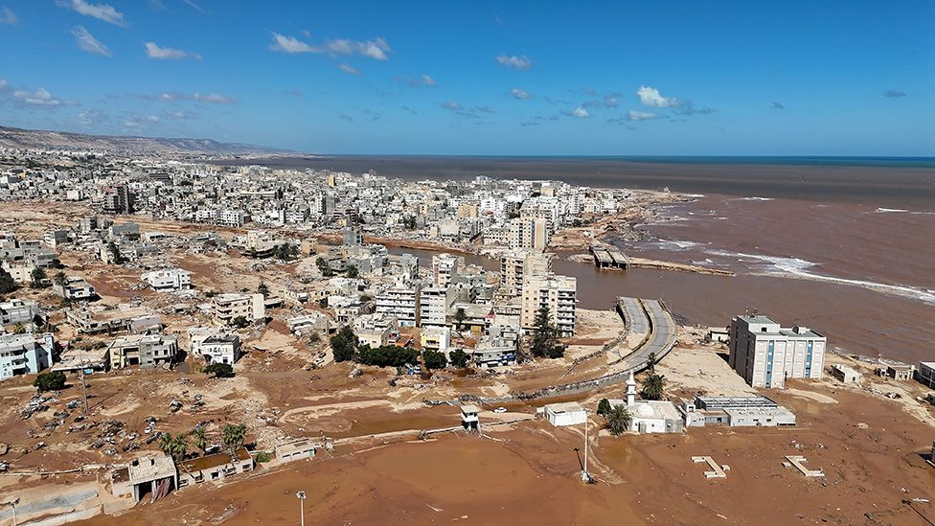
Why?
‘Africa is the continent most vulnerable to climate change, despite being responsible for just 2 to 3 percent of global carbon emissions and receiving only 3 percent of funding committed to climate mitigation and adaptation.’

Slide 3
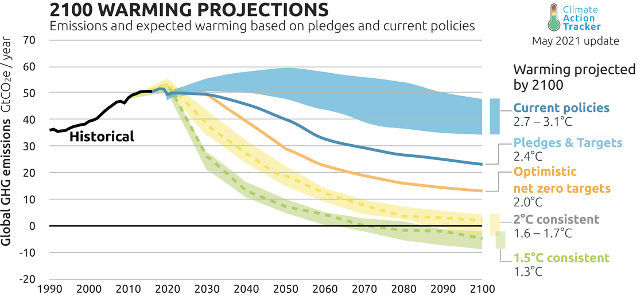
Climate risks are coming here Two choices: change or catastrophe
C0₂ concentrations¹ are at record levels and still rising
Different estimators offer a range of temperature projections but 3 – 4ºC by 2100 and rising often quoted based on current efforts²
A 4ºC rise is almost certainly inconsistent with our modern global economy
“In any case, we have no choice: a 2°C world might be insurable, a 4°C world certainly would not be.”
Henri de Castries, CEO AXA 2015
The Paris Agreement exists as there are two choices
Economic Collapse
Low carbon
transition
Chart Source: Climate Action Tracker, https://climateactiontracker.org/global/temperatures/
1. Throughout this presentation use of ”Carbon” or “CO₂” are used as a proxy for greenhouse gas emissions and their CO₂ equivalent impact on climate warming.
2. E.g. Schroder Climate Progress dashboard, 3.6^{O}C of warming https://www.schroders.com/en/uk/pensions/insights/climate-progress-dashboard/

Slide 4
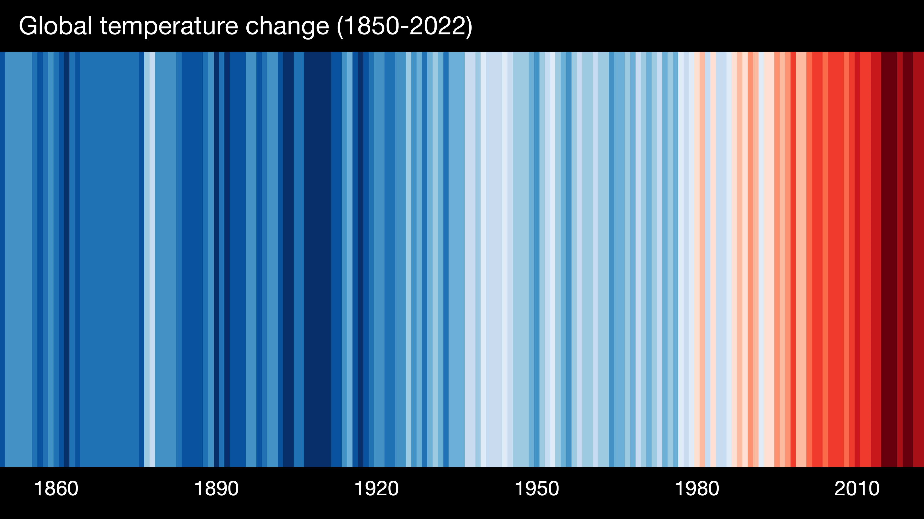
Climate risks are coming here
Chart Source: https://showyourstripes.info/

Slide 5
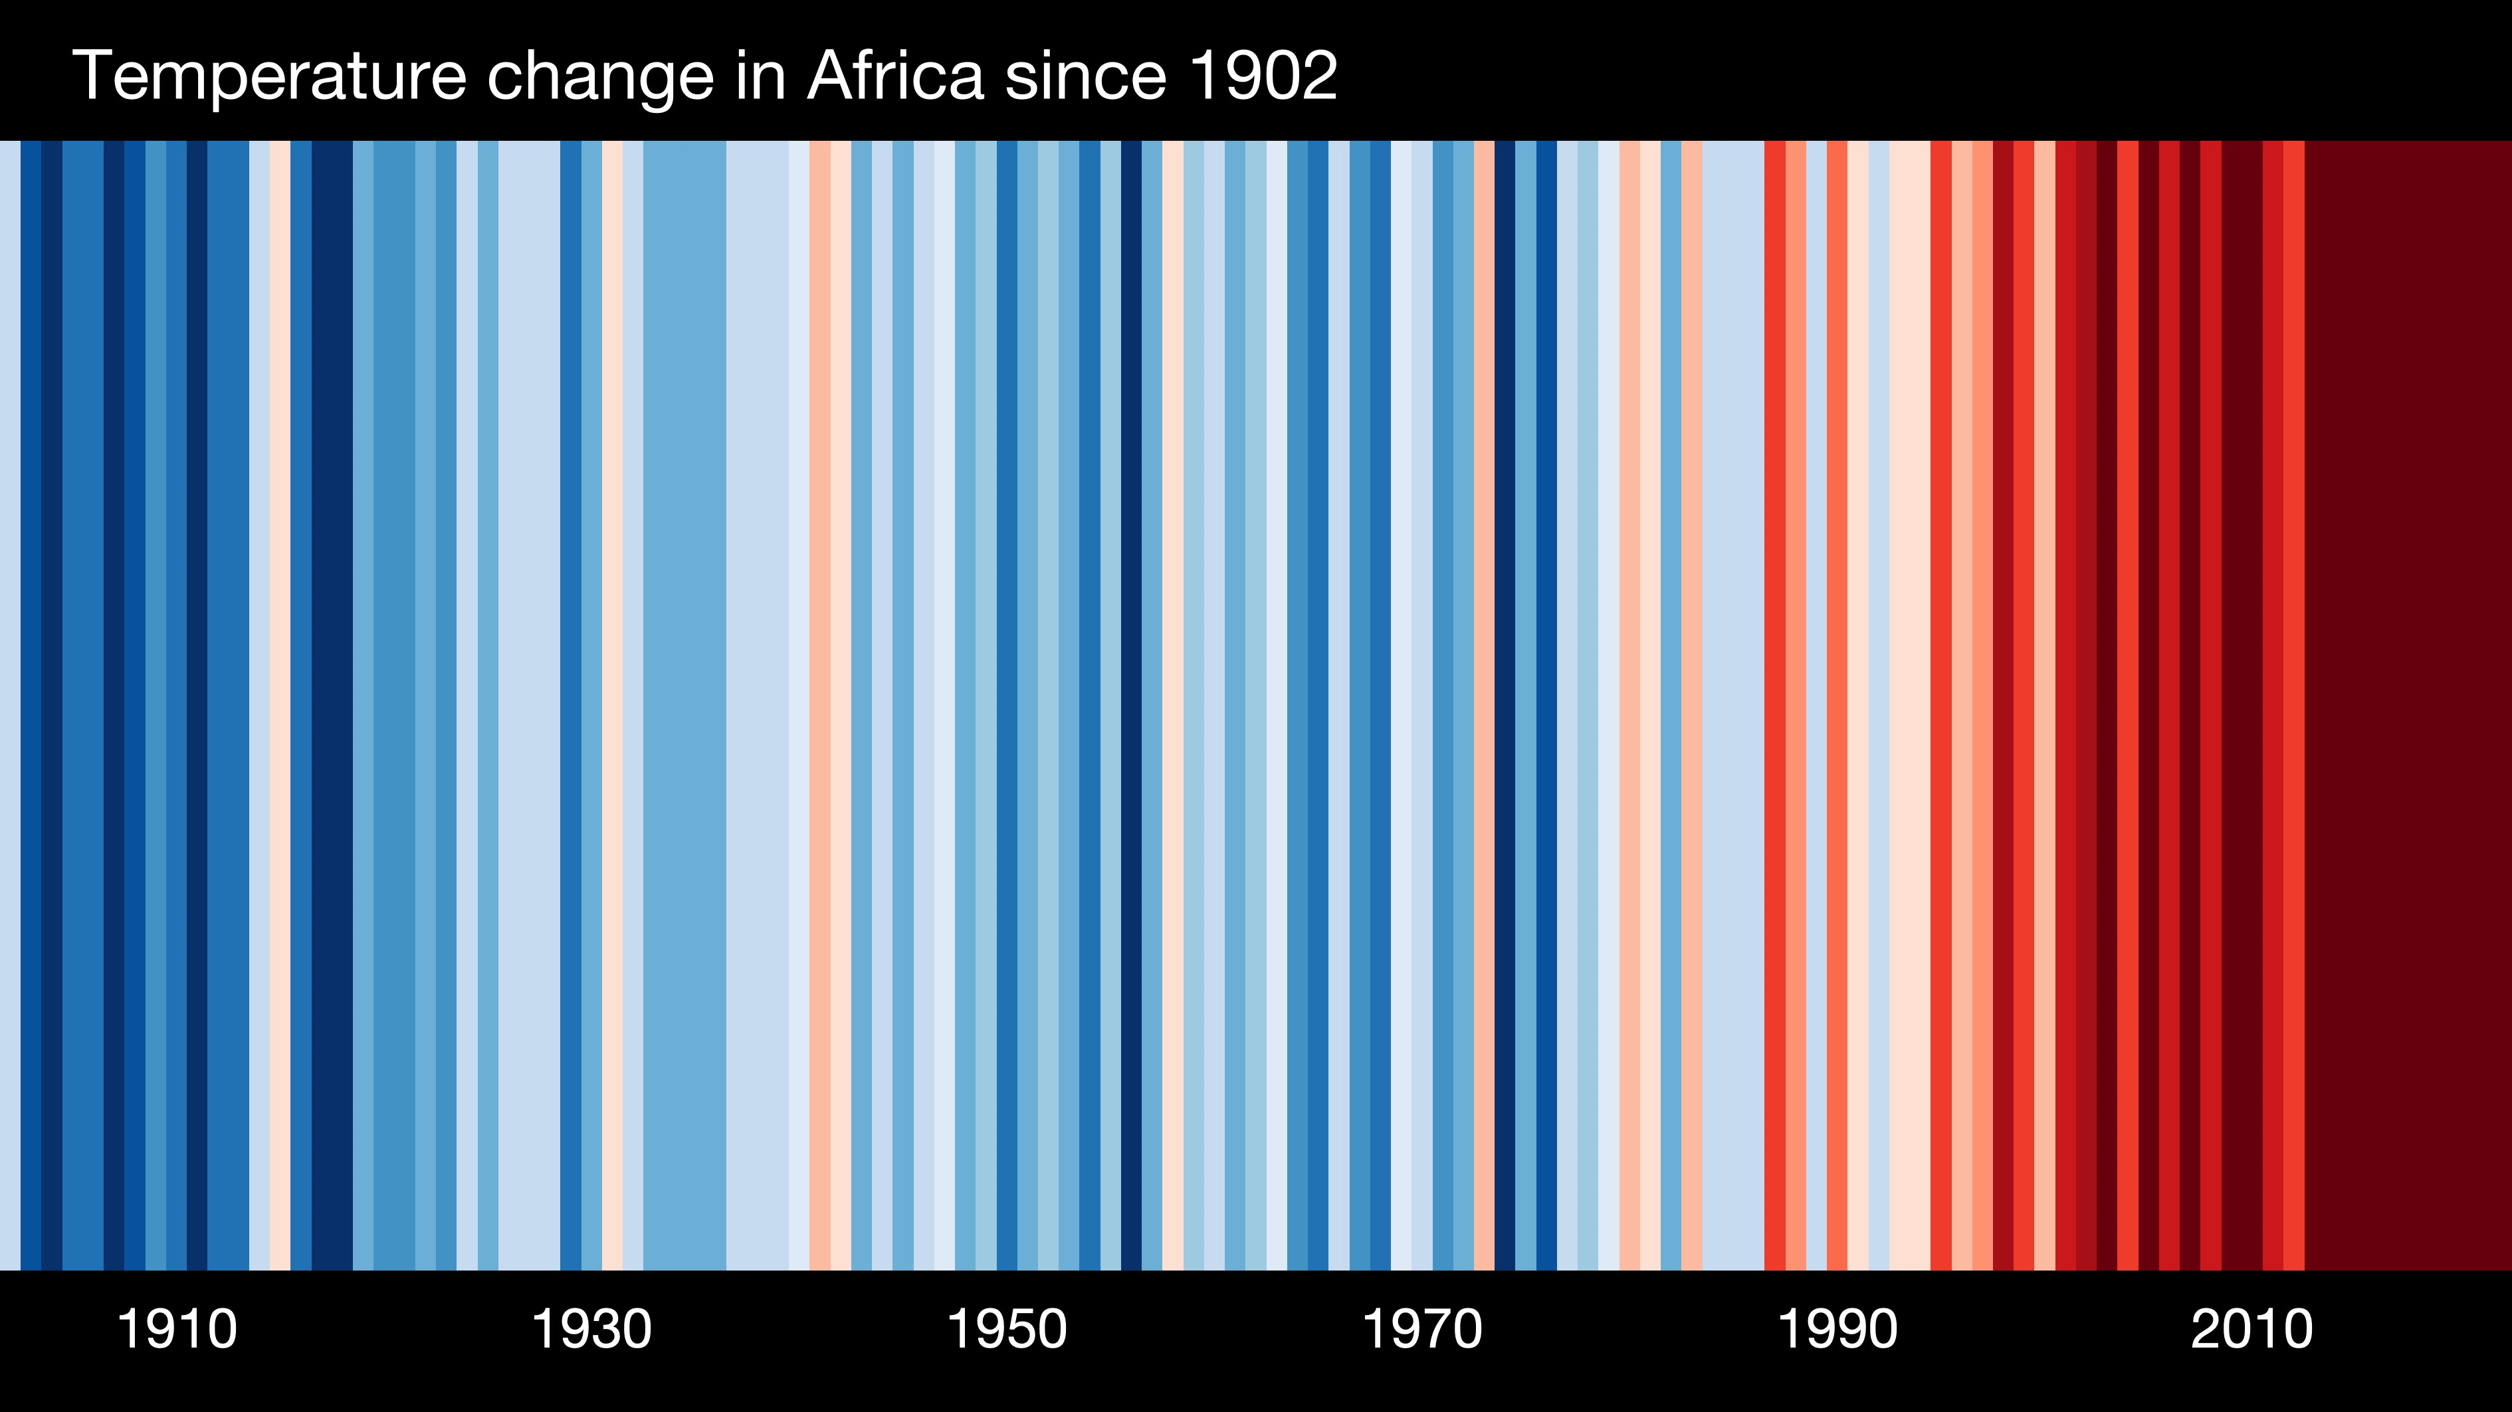
Climate risks are coming here
Chart Source: https://showyourstripes.info/

Slide 6
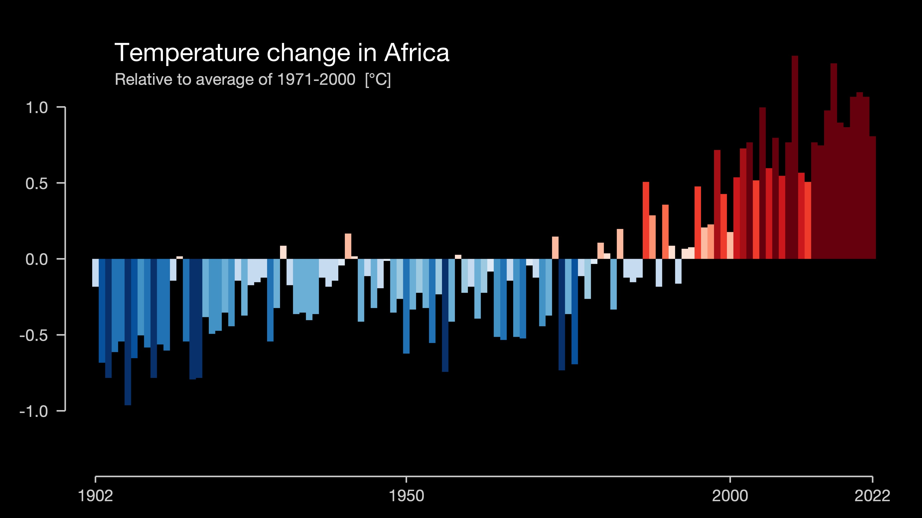
Climate risks are coming here
Chart Source: https://showyourstripes.info/

Slide 7
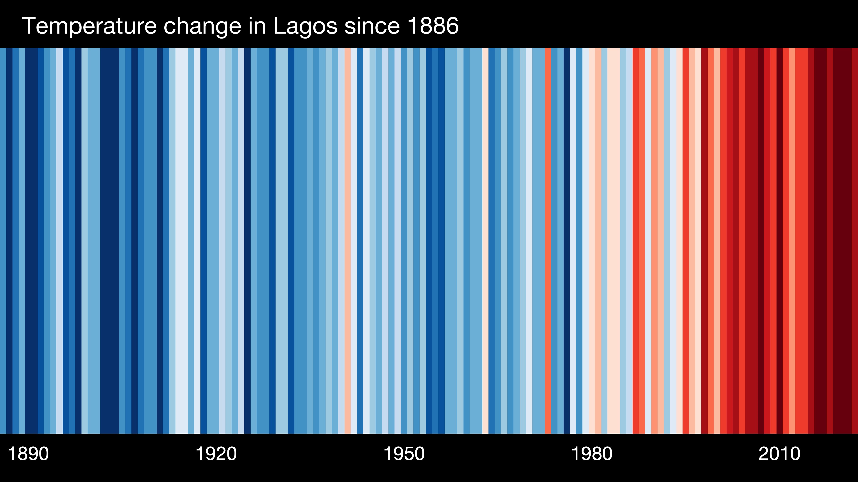
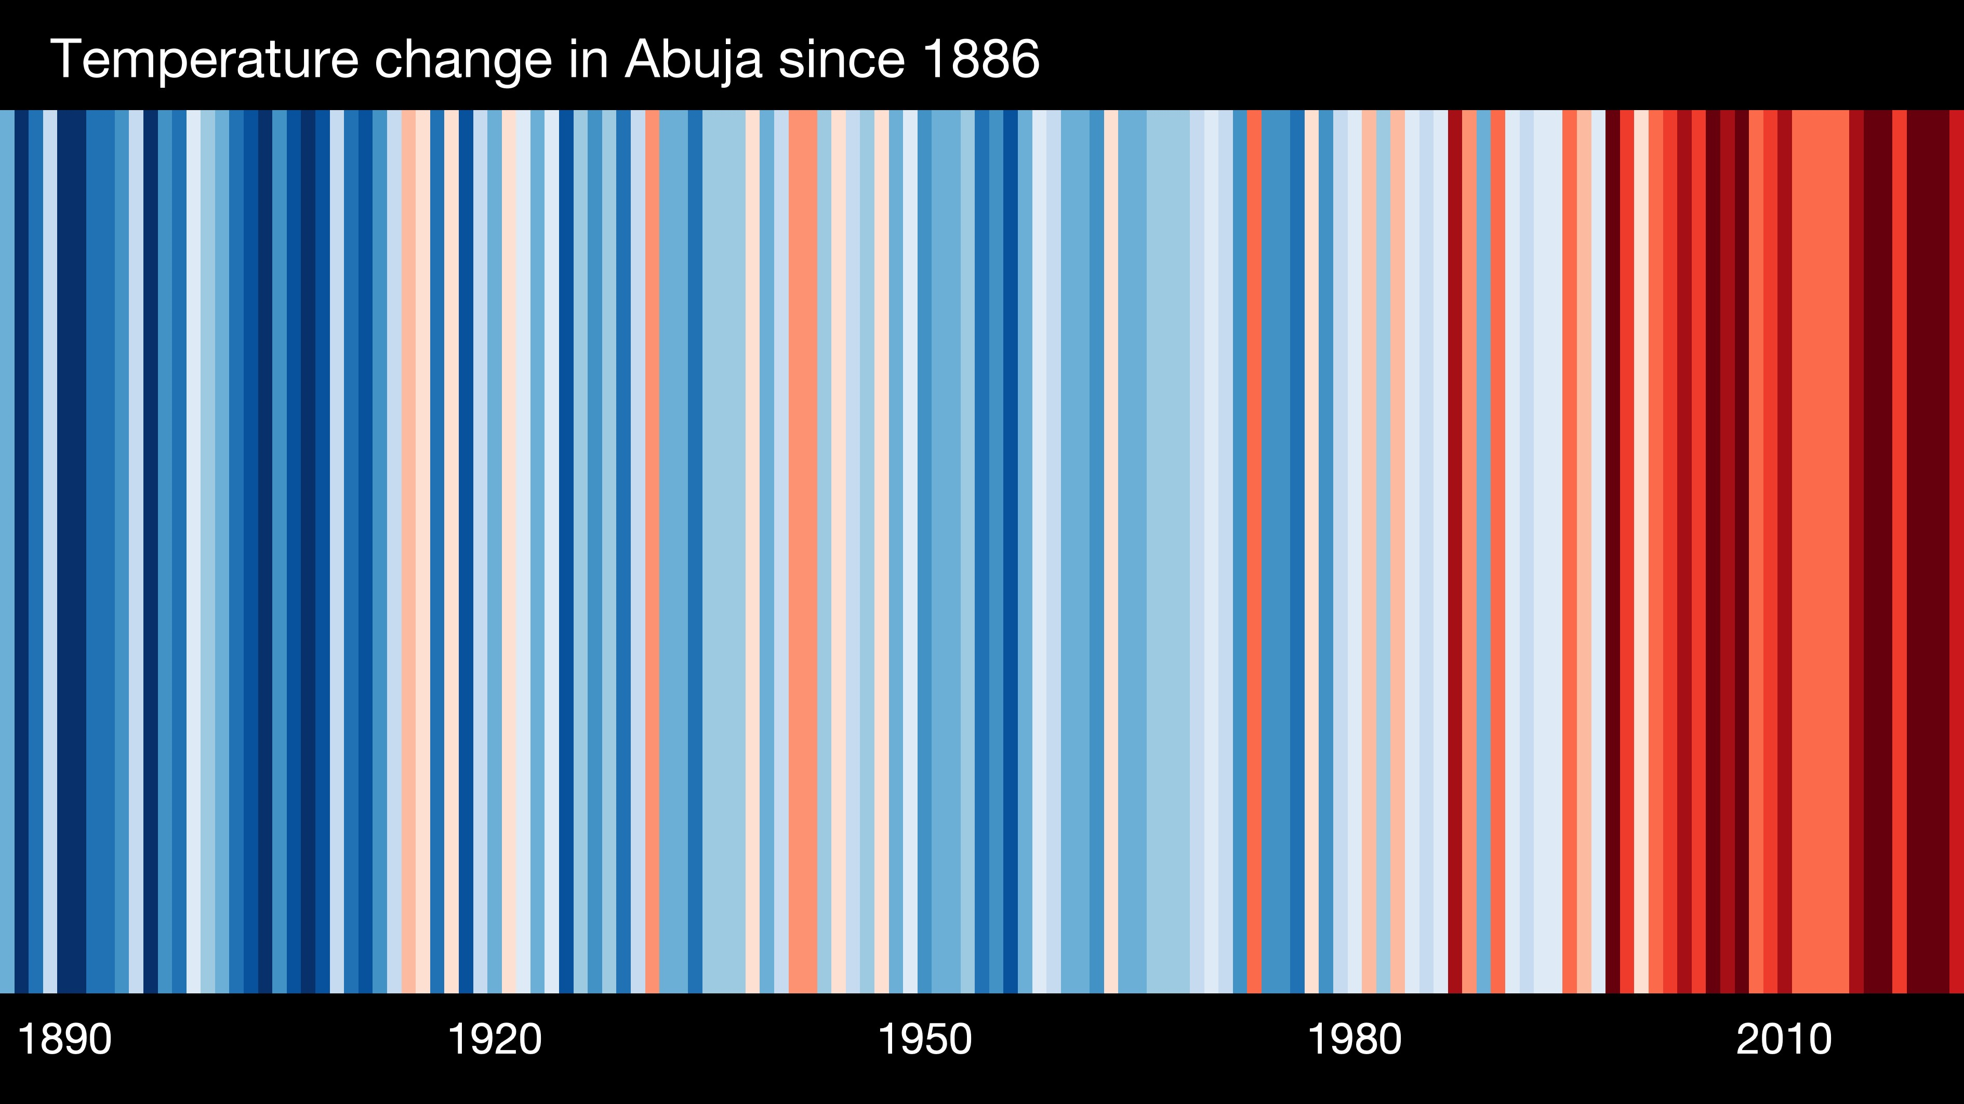
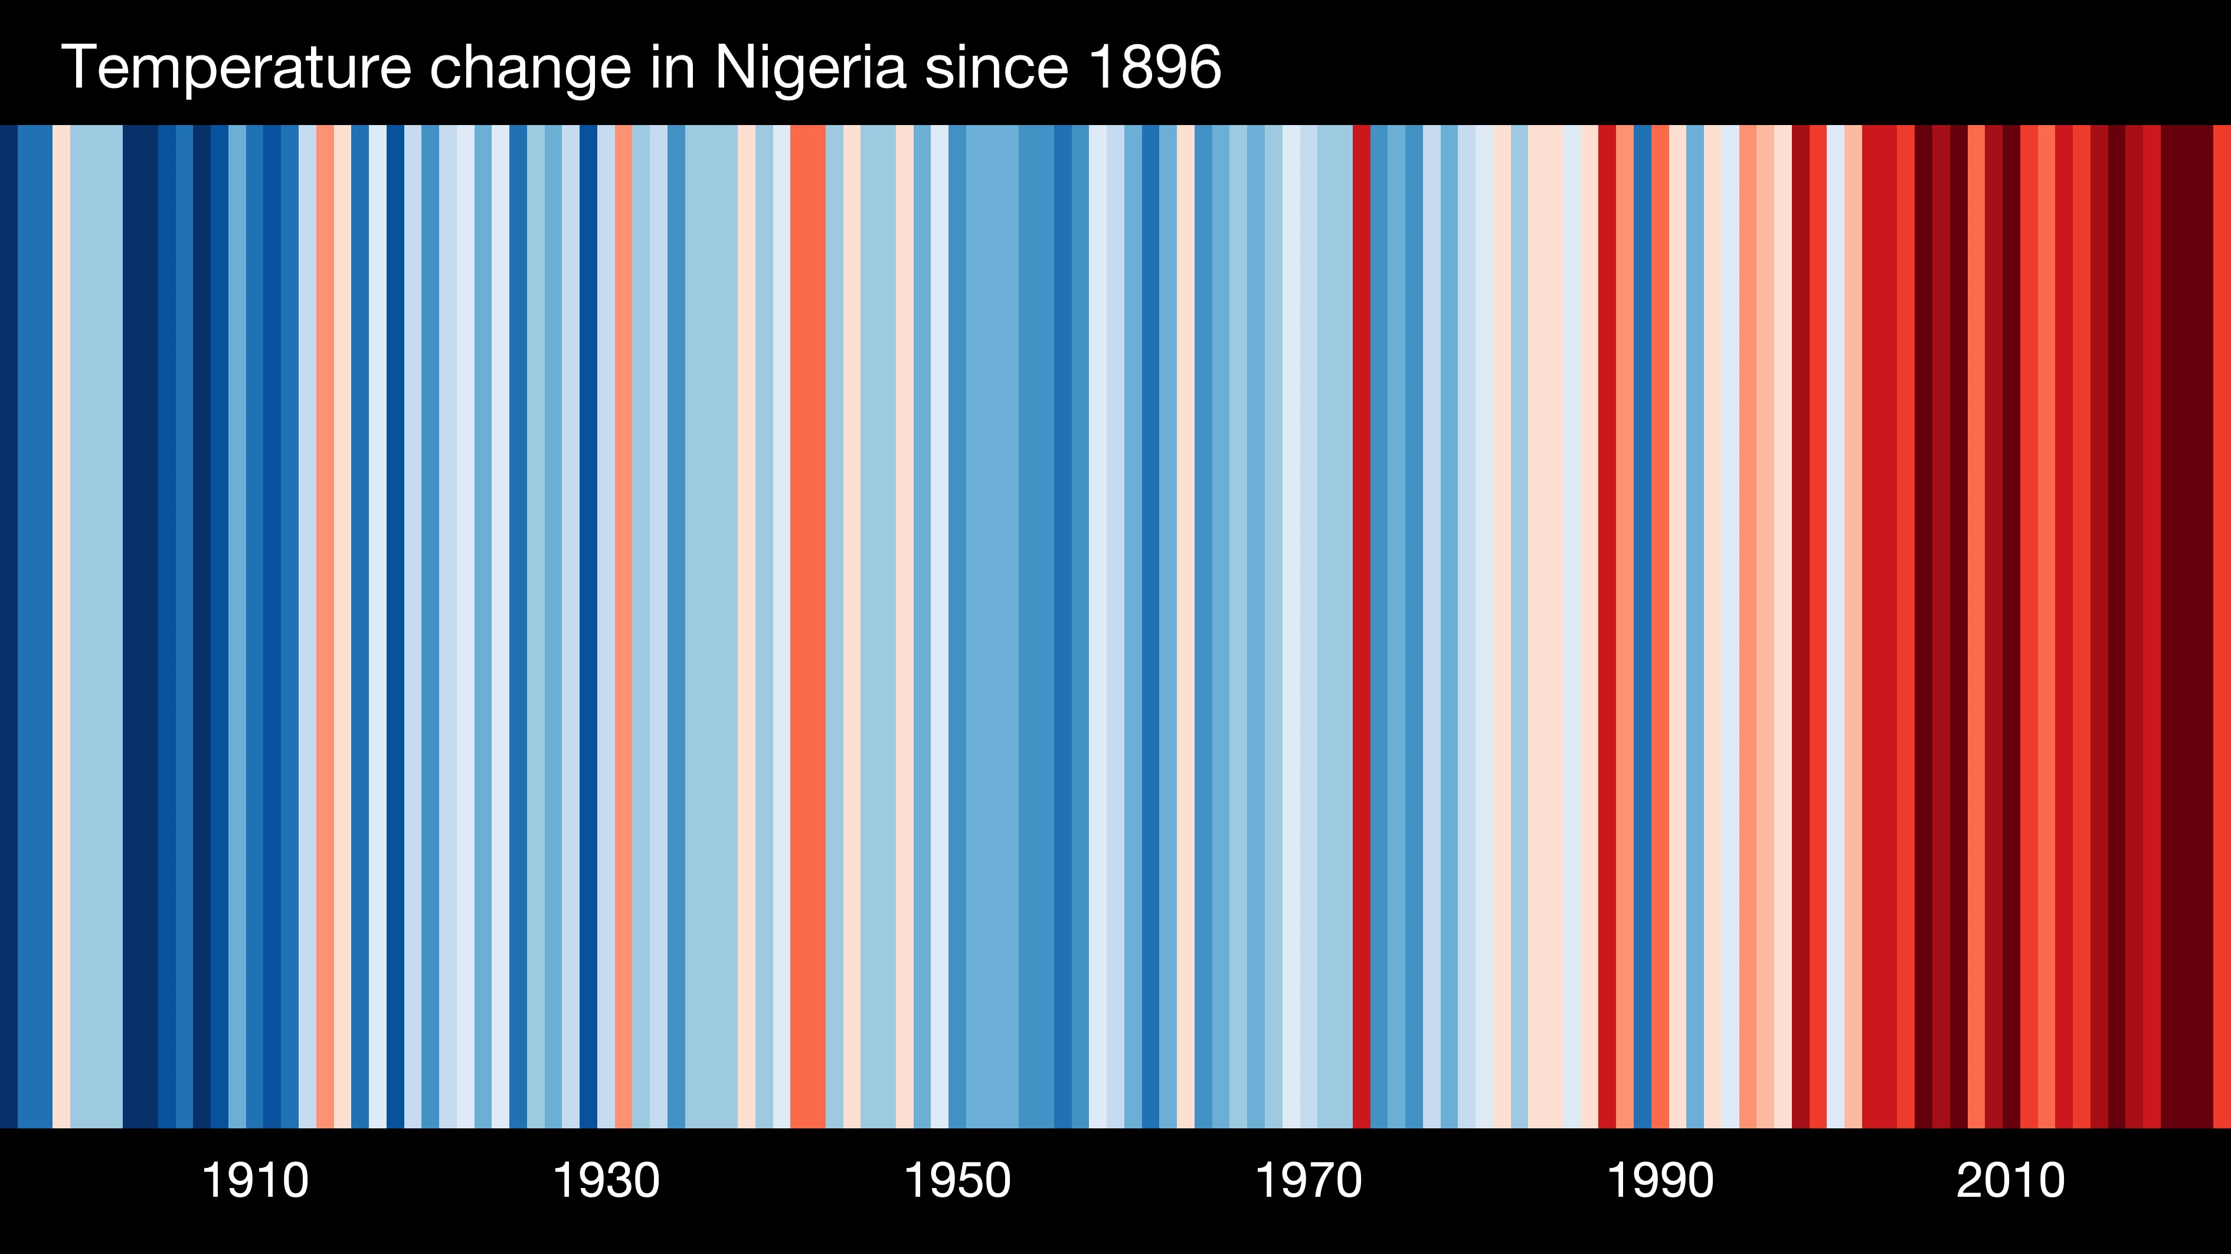
Climate risks are coming here
Chart Source: https://showyourstripes.info/

Slide 8
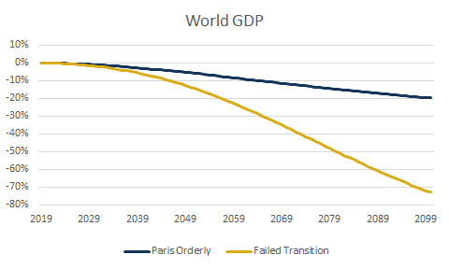
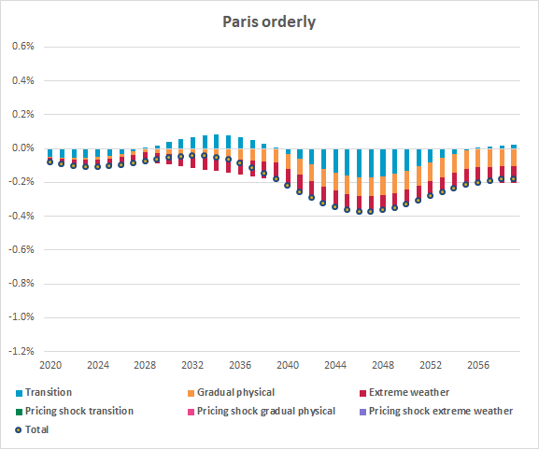
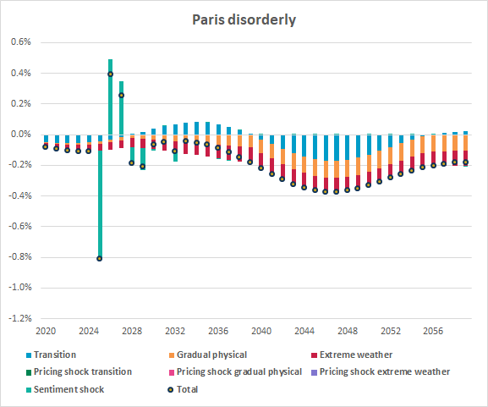
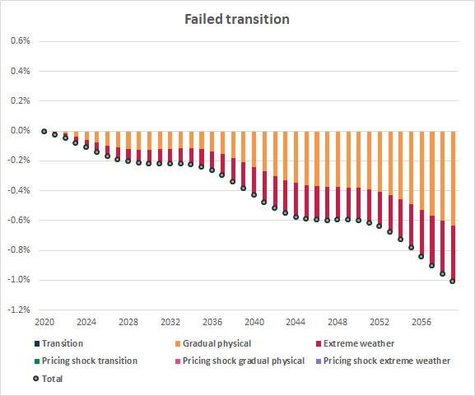
Climate GDP impacts are material in a failed transition IFoA/Ortec Finance paper on financial assumptions, June 2020
Figure 4: Climate-adjusted GDP growth across regions and climate pathways (cumulative difference to climate-uninformed baseline pathway)
Source: “Climate change considerations for actuarial financial assumptions and the role of scenario analysis”, June 2020 (Ortec Finance)
Figure 15: Percentage difference in the level of UK GDP explained by the various climate risk drivers (difference to climate-uninformed baseline pathway)

Slide 9
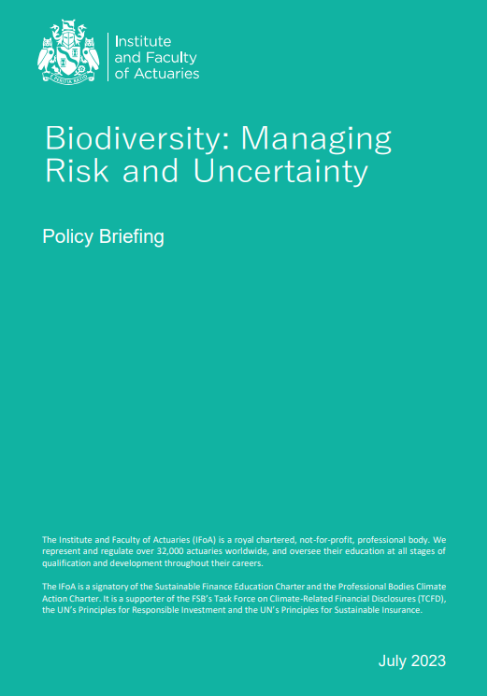
A biodiversity collapse and 6th mass extinction event
The situation is urgent
Nature-related financial disclosures are coming
The way we are consuming our natural resources is unsustainable
We need to take into account not just GDP but also social and natural capital
Nature loss is accelerated by climate change; restoring it can help mitigate climate change
Nature-related risk represents a material financial risk
Biodiversity loss poses a danger to health
It is not just an economic and social issue but also an equity issue
Research and
thought leadership

Slide 10
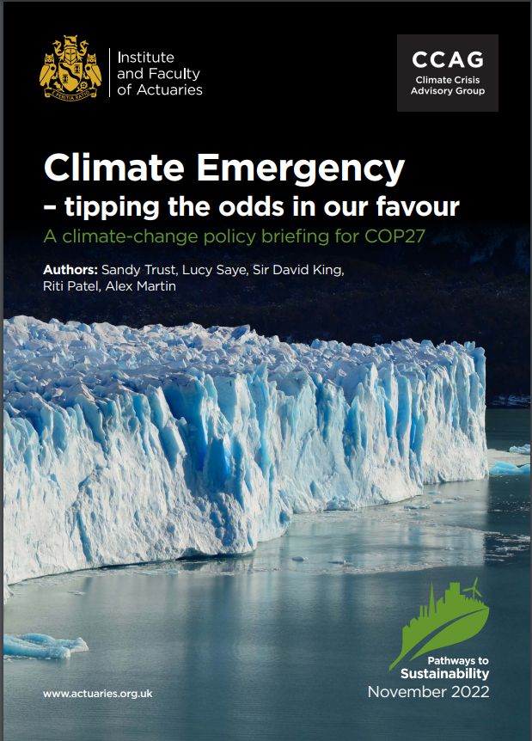
Applying the risk-management control cycle to climate change
The emergence of climate tipping points (risk identification)
Progressing faster than expected, with more severe impacts (risk monitoring)
Challenging to predict likely and possible outcomes (risk measurement)
Limited consideration of tail risks and adverse scenarios (risk measurement)
We should view 1.5˚C similar to a ruin scenario (risk control and identification)
Insufficient action to manage the risks we are facing (risk control)
A need to incorporate uncertainty by introducing prudence (risk control)
Knowledge and
skillsets
Notes:
We can replace the solvency of an insurance company with our shared objectives, those of the Paris Agreement to limit global warming and the United Nation’s Sustainable Development Goals, which have the overarching objective of ‘all people enjoying peace and prosperity’. Climate change is a clear risk to these goals. Viewed through this lens, we can assess the activities we are undertaking to manage climate-change risk and form a view as to whether these are adequate when compared to established risk-management standards.

Slide 11
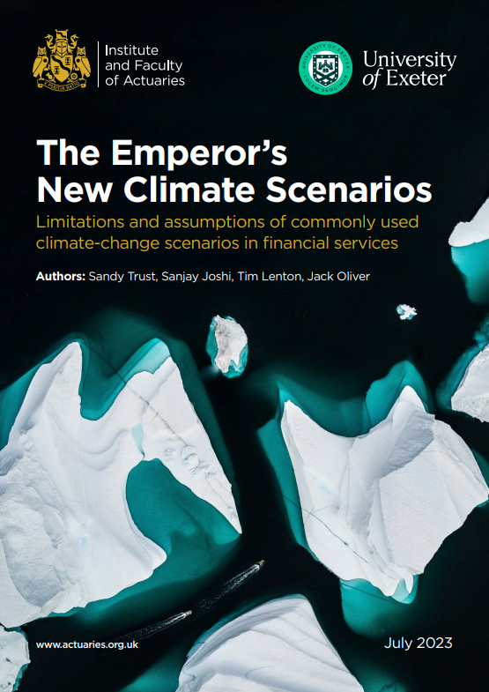
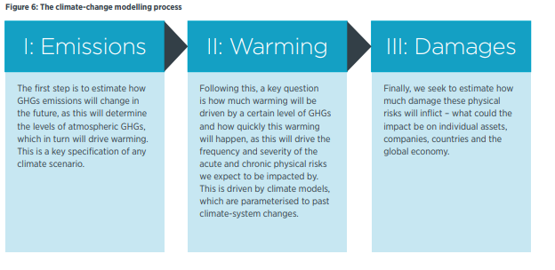
Climate-scenario modelling is a structured exploration of different plausible futures
‘Many climate models are severely under-estimating the economic impact of climate change.’
Research and
thought leadership

Slide 12
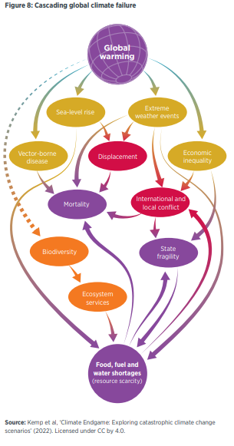
A fresh look at climate modelling?
Qualitative – rich narrative scenarios
‘Firms should develop qualitative scenarios that explore how these risks could cascade and what actions could be taken’
2. Quantitative – a new baseline and an updated loss function
‘Invert’ scenario analysis and use a
reverse stress test approach, as used in financial services risk
Management - rather than carrying out
climate-scenario analysis against a fictional world in which
climate change is not happening, we could work from a new
baseline of achieving the net-zero transition’
Research and
thought leadership

Slide 13
IFoA Taskforce
IFoA Council created Climate Related Risk Taskforce in September 2019
Objective: “enabling IFoA members to incorporate considerations of climate-related risk into their work, supporting them to take advantage of new opportunities, and considering the IFoA’s operational impact as a membership body”
38 Recommendations
covering governance and five key enablers
Knowledge and
skillsets
Regulation
Research and
thought leadership
Membership
Engagement
Internal
operations

Slide 14
Setting the Destination
01
02
03
Climate Policy
Statement
Green Finance
Education Charter
IFoA Sustainability Board
“The IFoA supports the aim of the Paris Agreement to limit climate change to an increase of substantially under 2°C from pre-industrial temperatures, and recognises that in order for there to be a reasonable probability of achieving this aim, there must be a transition to a global economy that has no net greenhouse gas emissions (‘net zero’) by 2050.”
The Green Finance Education Charter (GFEC) acts as a tool for focusing collaboration between government and industry. As a signatory, the IFoA commits to integrate green finance and sustainability into their core curricula, new qualifications and their members’ continued professional development.
Mission is to create meaningful engagement by all IFoA actuaries, their clients and wider stakeholders in understanding, and then in addressing, the risks and uncertainties for economic and financial systems arising from climate change and other sustainability issues. The Board seeks to be a centre of expertise and leadership for the IFoA in climate change and other sustainability issues and aims to help identify, educate and raise awareness of the need for such issues to be addressed.

Slide 15
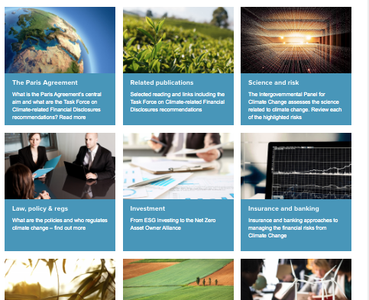
Climate Change: Knowledge & Skillsets
Climate Change Curated Library
Climate Change Curated Library¹
Practical Guides² (GI, Life, Pensions…)
Updated Associate & Fellowship syllabuses
Sustainability Certificate
Curated Climate Guide https://www.actuaries.org.uk/learn-and-develop/lifelong-learning/sustainability-and-lifelong-learning/climate-change-curated-library
Practical Guides: https://www.actuaries.org.uk/practice-areas/sustainability/sustainability-practice-area-practical-guides
Knowledge and
skillsets

Slide 16
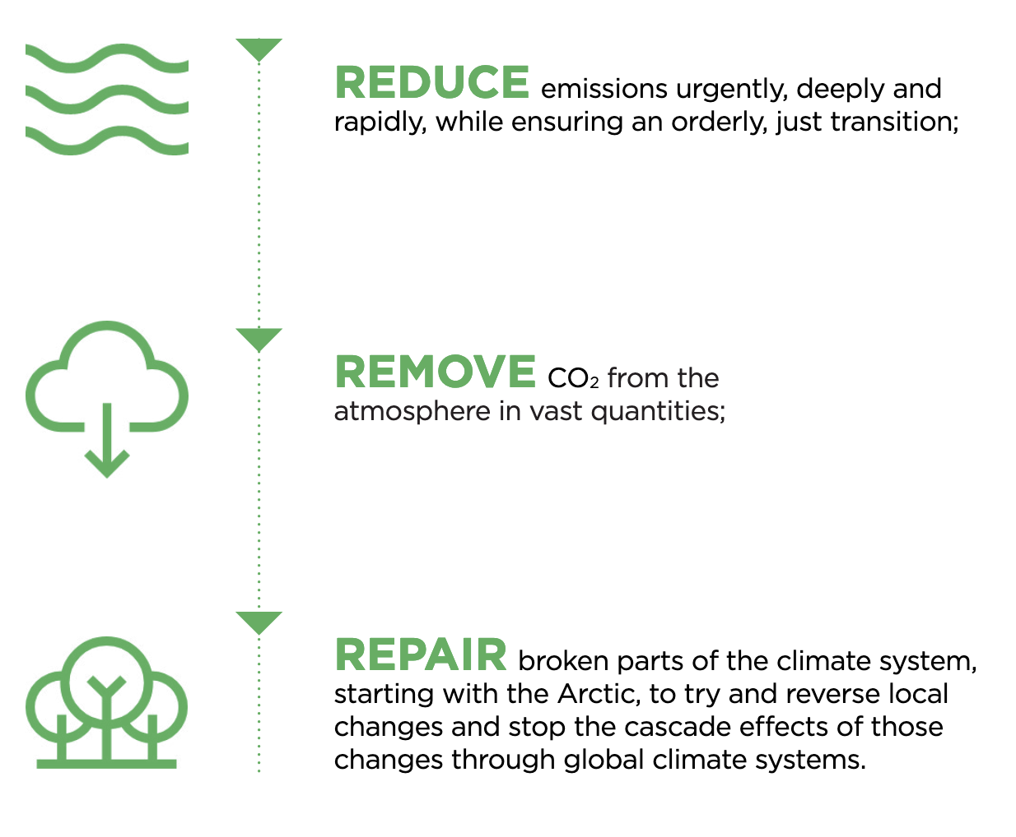
Solutions for a sustainable climate
The 3Rs - a strategy to ensure a manageable future :
Knowledge and
skillsets

Slide 17
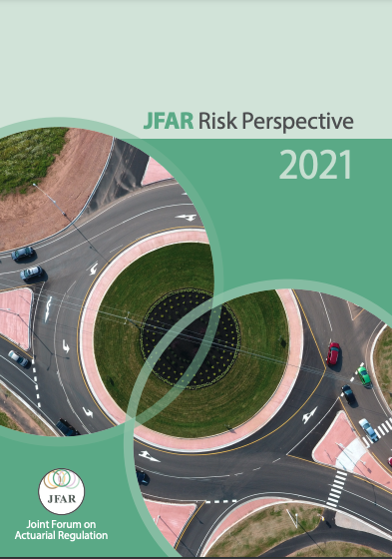
Climate Change: Regulation
Support Joint Forum for Actuarial Regulation (Climate Risk #1 hotspot)¹
Informal meetings with PRA and other regulators
Support IFoA regulation board: review Actuarial Code, APS, TAS
JFAR Risk Perspective 2021 https://www.frc.org.uk/getattachment/68762d12-5547-4d9b-a6a4-dbe4a1aacc4a/JFAR-Risk-Perspective-2021.pdf
Regulation

Slide 18
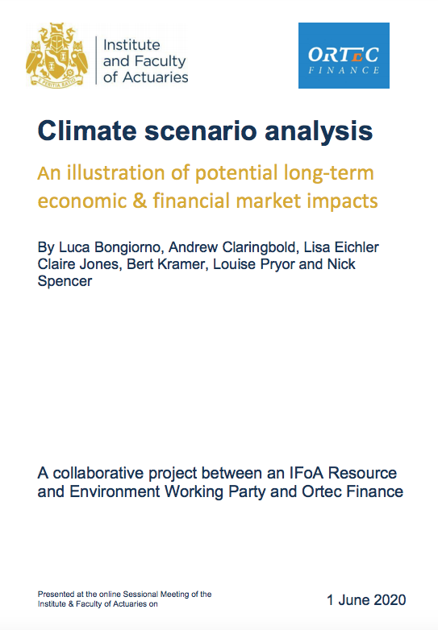
Climate Change: Research & Thought-Leadership
Research program including Climate scenario analysis, TCFD, carbon offsets^{1,}
Climate Change for Actuaries: An Introduction²
Public Interest & Thought-Leadership events (e.g. Wicked Problems, Finance in the Public Interest)³
FinSTIC & Economics MIG⁴
‘Beyond” Climate change: biodiversity, intergenerational fairness⁵
Climate scenario analysis - An illustration of potential long-term economic & financial market impacts, Climate Scenario Analysis for Pension Schemes,, https://www.iema.net/knowledge/policy-horizon/corporate-sustainability/climate-related-financial-disclosures
https://www.actuaries.org.uk/system/files/field/document/Climate-change-report-29072020.pdf
https://www.actuaries.org.uk/learn-and-develop/events-calendar/thought-leadership-speaker-series
https://finstic.org.uk/
http://blog.actuaries.org.uk/blog/biodiversity-risk-natural-capital-and-actuarial-practice , https://www.actuaries.org.uk/news-and-insights/public-affairs-and-policy/intergenerational-fairness
Research and
thought leadership

Slide 19
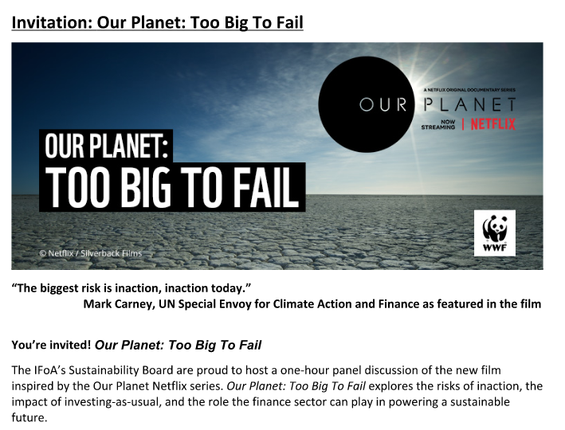
Climate Change: Member Engagement
IFoA Practice Board engagement plans
Events¹
Sessional meetings, regional, climate hotspot webinar, public interest
Weekly Newsletter²
LinkedIn Group
Sustainability Volunteer Group³
Film Club, Book Club
The Actuary articles, IFoA blog, podcasts⁴ etc
https://www.actuaries.org.uk/learn-and-develop/conference-paper-archive/2020
Sign up to the Newsletter and the LinkedIn group
Sustainability Volunteer Group
Eg https://www.theactuary.com/2021/03/03/march-2021-digital-issue, https://blog.actuaries.org.uk/blog/bringing-sustainability-forefront-covid-19-recovery, https://www.actuaries.org.uk/practice-areas/sustainability/sustainable-development-goals-sdg-podcasts
Membership
Engagement

Slide 20
Thank you!
Any questions?

